Slide 1

Matriz Energética Brasileira e as Convenções Internacionais sobre Mudanças Climáticas
Ministério de Ciência, Tecnoligia e Inovação
Secretaria de Política de Programas de Pesquisa e Desenvolvimento- SEPED
Osvaldo Moraes
IX Simpósio Internacional de Qualidade Ambiental
Porto Alegre – Maio de 2014

Slide 2
Sumário da Apresentação a) Tópicos do IPCC b) Política Nacional de Mudanças do Clima c) Setor de Energia e a Comunicação Nacional da Mudança do Clima
Ministério de Ciência, Tecnoligia e Inovação
Secretaria de Política de Programas de Pesquisa e Desenvolvimento- SEPED

Slide 3
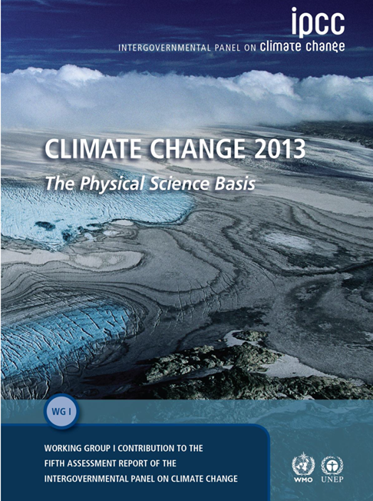

Slide 4

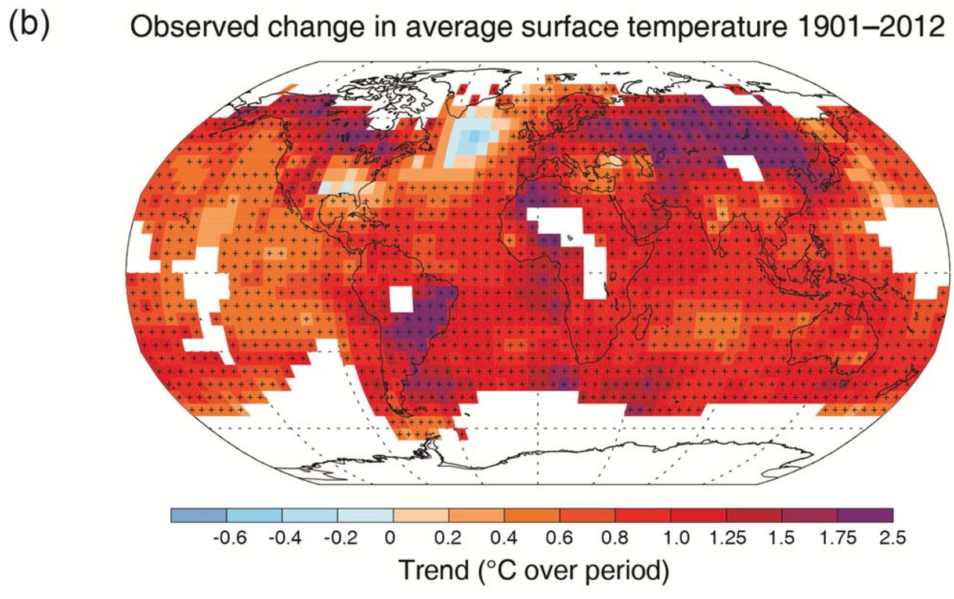
Ministry of Science, Technology and Innovation of Brazil
Secretariat of Policies and Programs of Research and Development - SEPED
B.1 Atmosphere
Warming in the climate system is unequivocal
(IPCC 2013, Fig. SPM.1b)
Figure SPM.1 (b) Map of the observed surface temperature change from 1901 to 2012 derived from temperature trends determined by linear regression from one dataset
Notes:
(b) Map of the observed surface temperature change from 1901 to 2012 derived from temperature trends determined by linear regression from one dataset (orange line in panel a). Trends have
been calculated where data availability permits a robust estimate (i.e., only for grid boxes with greater than 70% complete records and more than 20% data availability in the first and last 10% of the time period). Other areas are white. Grid boxes where the trend is significant at the 10% level are indicated by a + sign.

Slide 5
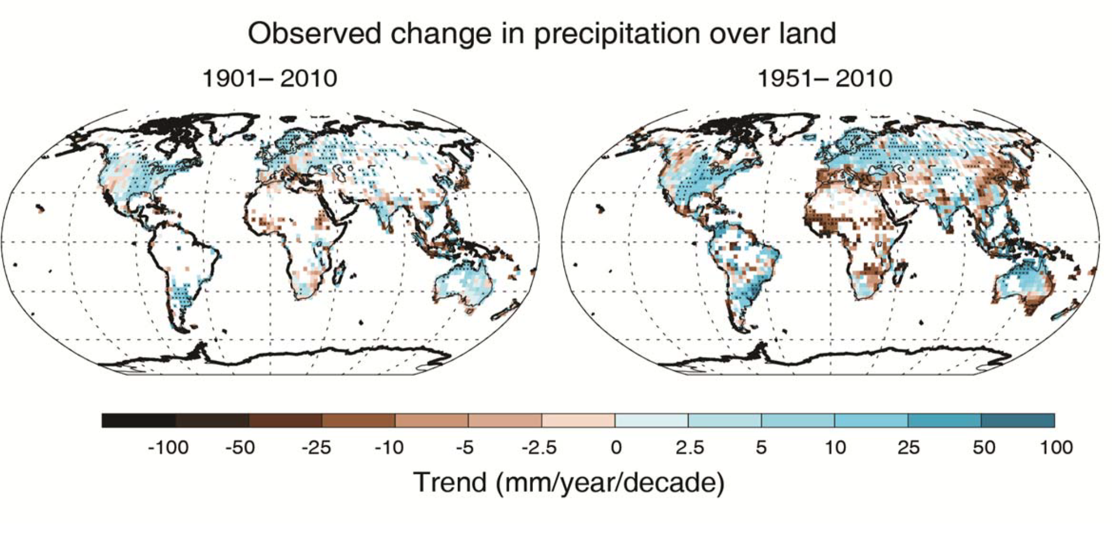
B.1 Atmosphere
Figure SPM.2: Maps of observed precipitation change from 1901 to 2010 and from 1951 to 2010 (trends calculated using the same criteria as in Figure SPM.1b) from one data set
Notes:
Figure SPM.2: Maps of observed precipitation change from 1901 to 2010 and from 1951 to 2010 (trends calculated using the same criteria as in Figure SPM.1b) from one data set.

Slide 6
D. Understanding the Climate System and its Recent Changes
D.1 Evaluation of Climate Models
D.2 Quantification of Climate System Responses

Slide 7
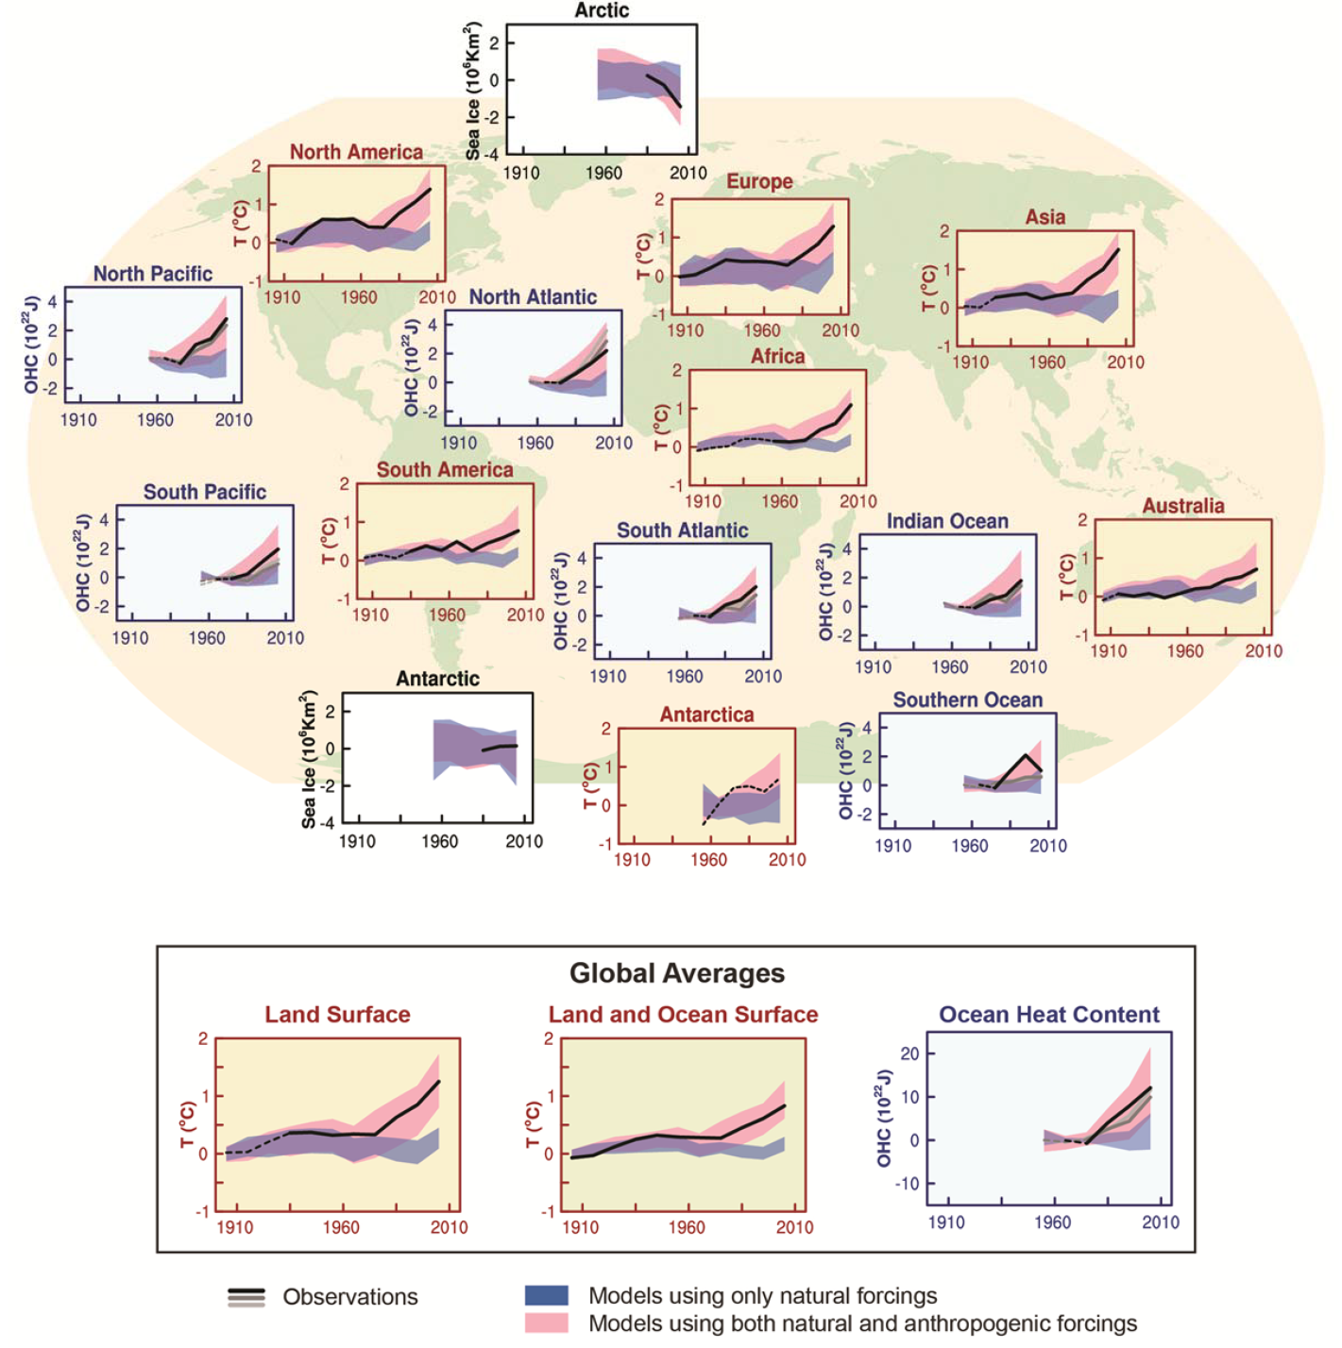
D.3 Detection and Attribution of Climate Change
Figure SPM.6: Comparison of observed and simulated climate change based on three large-scale indicators in the atmosphere, the cryosphere and the ocean
Human influence on the climate system is clear
Notes:
Figure SPM.6: Comparison of observed and simulated climate change based on three large-scale indicators in the atmosphere, the cryosphere and the ocean: change in continental land surface air temperatures (yellow panels), Arctic and Antarctic September sea ice extent (white panels), and upper ocean heat content in the major ocean basins (blue panels). Global average changes are also given. Anomalies are given relative to 1880–1919 for surface temperatures, 1960–1980 for ocean heat content and 1979–1999 for sea ice. All time-series are decadal averages, plotted at the centre of the decade. For temperature panels, observations are dashed lines if the spatial coverage of areas being examined is below 50%. For ocean heat content and sea ice panels the solid line is where the coverage of data is good and higher in quality, and the dashed line is where the data coverage is only adequate, and thus, uncertainty is larger. Model results shown are Coupled Model Intercomparison Project Phase 5 (CMIP5) multi-model ensemble ranges, with shaded bands indicating the 5 to 95% confidence intervals.

Slide 8
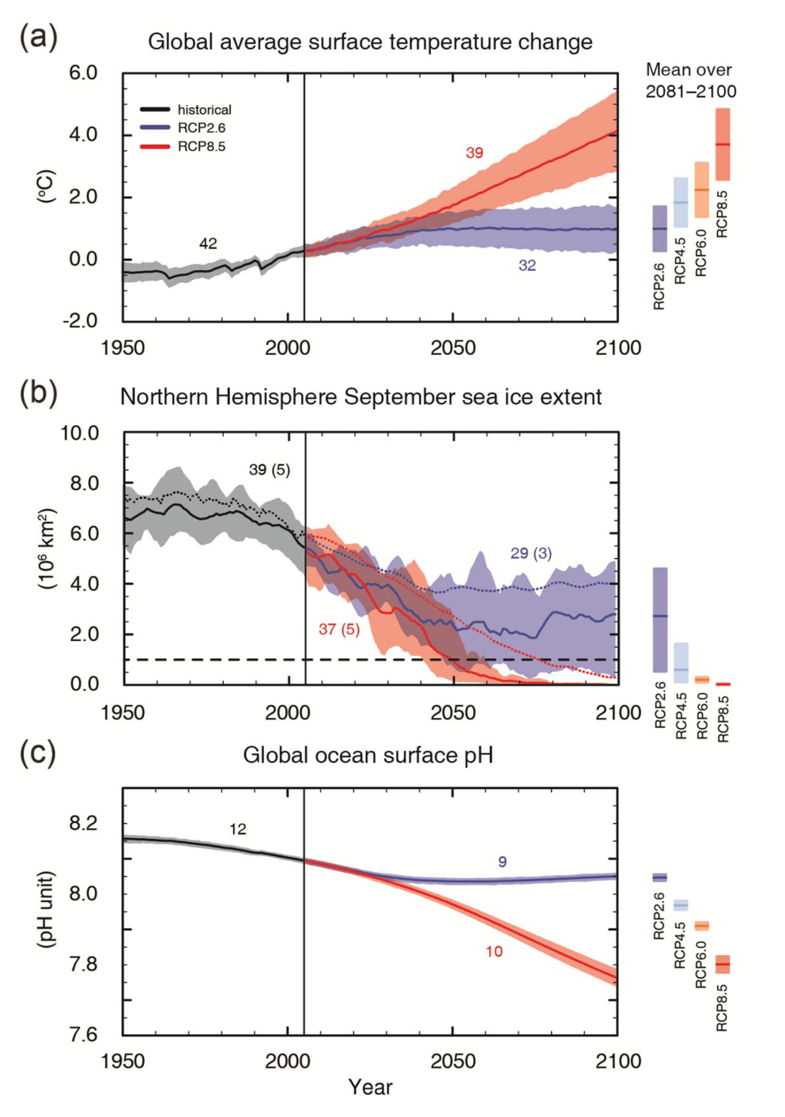
CMIP5 - Coupled Model Intercomparison Project Phase 5
E. Future Global and Regional Climate Change
Figure SPM.7: CMIP5 multi-model simulated time series from 1950 to 2100 for :
change in global annual mean surface temperature relative to 1986–2005 (see Table SPM.2 for other reference periods),
Northern Hemisphere September sea ice extent (5 year running mean) and
global mean ocean surface pH. Time series of projections and a measure of uncertainty (shading) are shown for scenarios RCP2.6 (blue) and RCP8.5 (red). Black (grey shading) is the modelled historical evolution using historical reconstructed forcings.
The four RCPs, RCP2.6, RCP4.5, RCP6, and RCP8.5, are named after a possible range of radiative forcing values in the year 2100 relative to pre-industrial values (+2.6, +4.5, +6.0, and +8.5 W/m², respectively).
In simple terms, radiative forcing is "...the rate of energy change per unit area of the globe as measured at the top of the atmosphere."
Notes:
Figure SPM.7: CMIP5 multi-model simulated time series from 1950 to 2100 for
change in global annual mean surface temperature relative to 1986–2005 (see Table SPM.2 for other reference periods),
Northern Hemisphere September sea ice extent (5 year running mean) and
global mean ocean surface pH. Time series of projections and a measure of uncertainty (shading) are shown for scenarios RCP2.6 (blue) and RCP8.5 (red). Black (grey shading) is the modelled historical evolution using historical reconstructed forcings.
The mean and associated uncertainties averaged over 2081−2100 are given for all RCP scenarios as colored vertical bars. The numbers of CMIP5 models used to calculate the multi-model mean is indicated. For sea ice extent (b), the projected mean and uncertainty (minimum-maximum range) of the subset of models that most closely reproduce the climatological mean state and 1979‒2012 trend of the Arctic sea ice is given (number of models given in brackets). For completeness, the CMIP5 multi-model mean is also indicated with dotted lines. The dashed line represents nearly ice-free conditions (i.e., when sea ice extent is less than 106 km2 for at least five consecutive years).

Slide 9
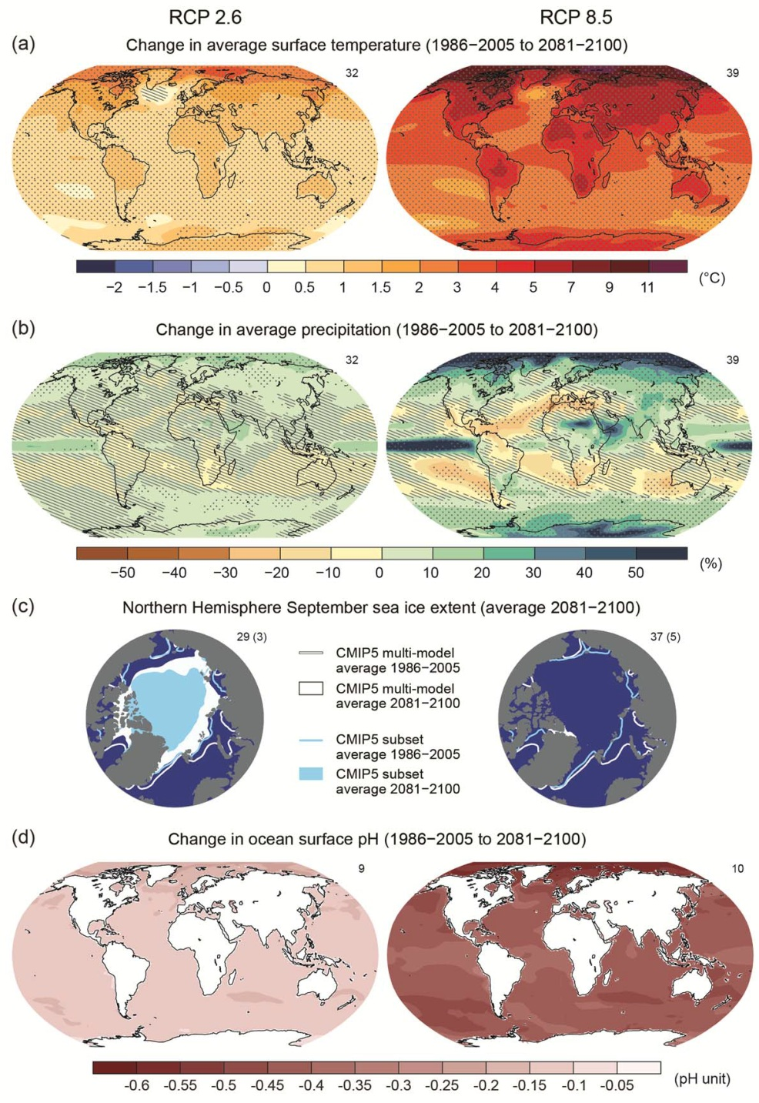
E. Future Global and Regional Climate Change
Figure SPM.8: Maps of CMIP5 multi-model mean results for the scenarios RCP2.6 and RCP8.5 in 2081–2100 of
(a) annual mean surface temperature change,
(b) average percent change in annual mean precipitation,
(c) Northern Hemisphere September sea ice extent and
(d) change in ocean surface pH.
Notes:
Figure SPM.8: Maps of CMIP5 multi-model mean results for the scenarios RCP2.6 and RCP8.5 in 2081–2100 of
(a) annual mean surface temperature change,
(b) average percent change in annual mean precipitation,
(c) Northern Hemisphere September sea ice extent and
(d) change in ocean surface pH.
Changes in panels (a), (b) and (d) are shown relative to 1986–2005. The number of CMIP5 models used to calculate the multi-model mean is indicated in the upper right corner of each panel. For panels (a) and (b), hatching indicates regions where the multi-model mean is small compared to internal variability (i.e., less than one standard deviation of internal variability in 20-year means). Stippling indicates regions where the multi-model mean is large compared to internal variability (i.e., greater than two standard deviations of internal variability in 20-year means) and where 90% of models agree on the sign of change (see Box 12.1).
In panel (c), the lines are the modelled means for 1986−2005; the filled areas are for the end of the century.
The CMIP5 multi-model mean is given in white colour, the projected mean sea ice extent of a subset of models (number of models given in brackets) that most closely reproduce the climatological mean state and
1979‒2012 trend of the Arctic sea ice extent is given in light blue colour.

Slide 10
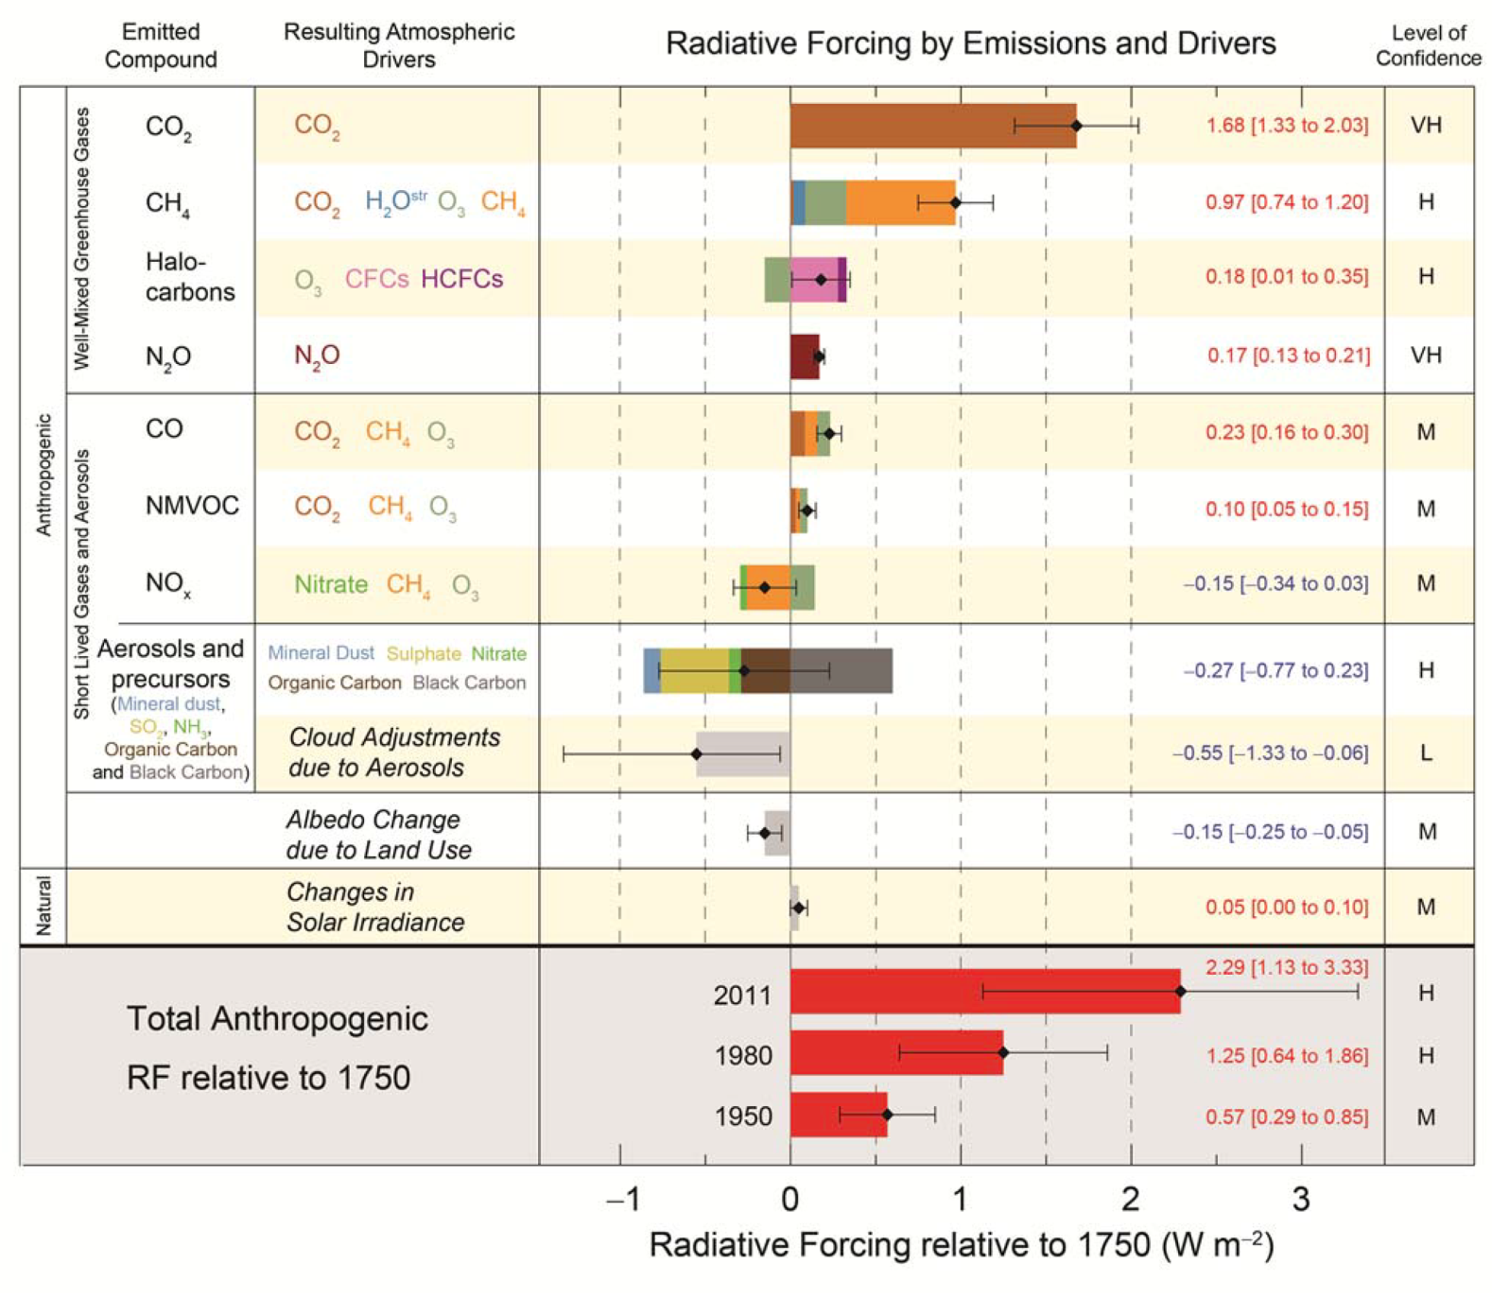
C. Drivers of Climate Change
Figure SPM.5: Radiative forcing estimates in 2011 relative to 1750 and aggregated uncertainties for the main drivers of climate change.
Notes:
Figure SPM.5: Radiative forcing estimates in 2011 relative to 1750 and aggregated uncertainties for the main drivers of climate change. Values are global average radiative forcing (RF15) partitioned according to the emitted compounds or processes that result in a combination of drivers. The best estimates of the net radiative forcing are shown as black diamonds with corresponding uncertainty intervals; the numerical values are provided on the right of the figure, together with the confidence level in the net forcing (VH – very high, H – high, M – medium, L – low, VL – very low). Albedo forcing due to black carbon on snow and ice is included in the black carbon aerosol bar. Small forcings due to contrails (0.05 W m–2, including contrail induced cirrus), and HFCs, PFCs and SF6 (total 0.03 W m–2) are not shown. Concentration-based RFs for gases can be obtained by summing the like-coloured bars. Volcanic forcing is not included as its episodic nature makes is difficult to compare to other forcing mechanisms. Total anthropogenic radiative forcing is provided for three
different years relative to 1750.

Slide 11
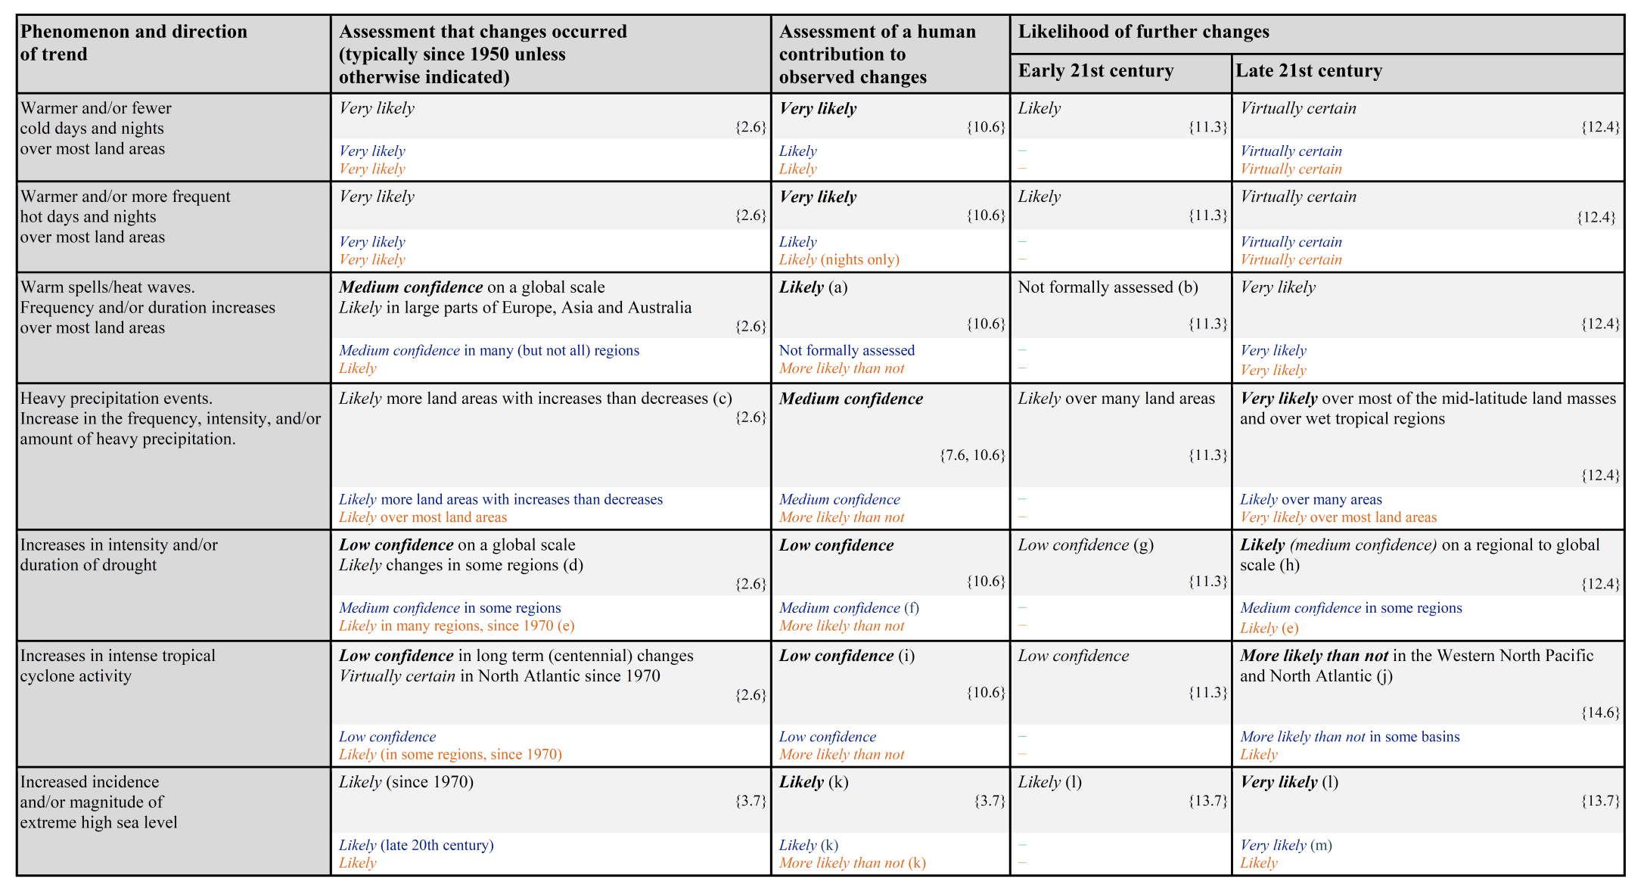
Table SPM.1: Extreme weather and climate events: Global-scale assessment of recent observed changes, human contribution to the changes, and projected further changes for the early (2016–2035) and late (2081–2100) 21st century
Notes:
Table SPM.1: Extreme weather and climate events: Global-scale assessment of recent observed changes, human contribution to the changes, and projected further changes for the early (2016–2035) and late (2081–
2100) 21st century. Bold indicates where the AR5 (black) provides a revised* global-scale assessment from the SREX (blue) or AR4 (red). Projections for early 21st century were not provided in previous assessment
reports. Projections in the AR5 are relative to the reference period of 1986–2005, and use the new Representative Concentration Pathway (RCP) scenarios (see Box SPM.1) unless otherwise specified. See the Glossary for definitions of extreme weather and climate events.

Slide 12
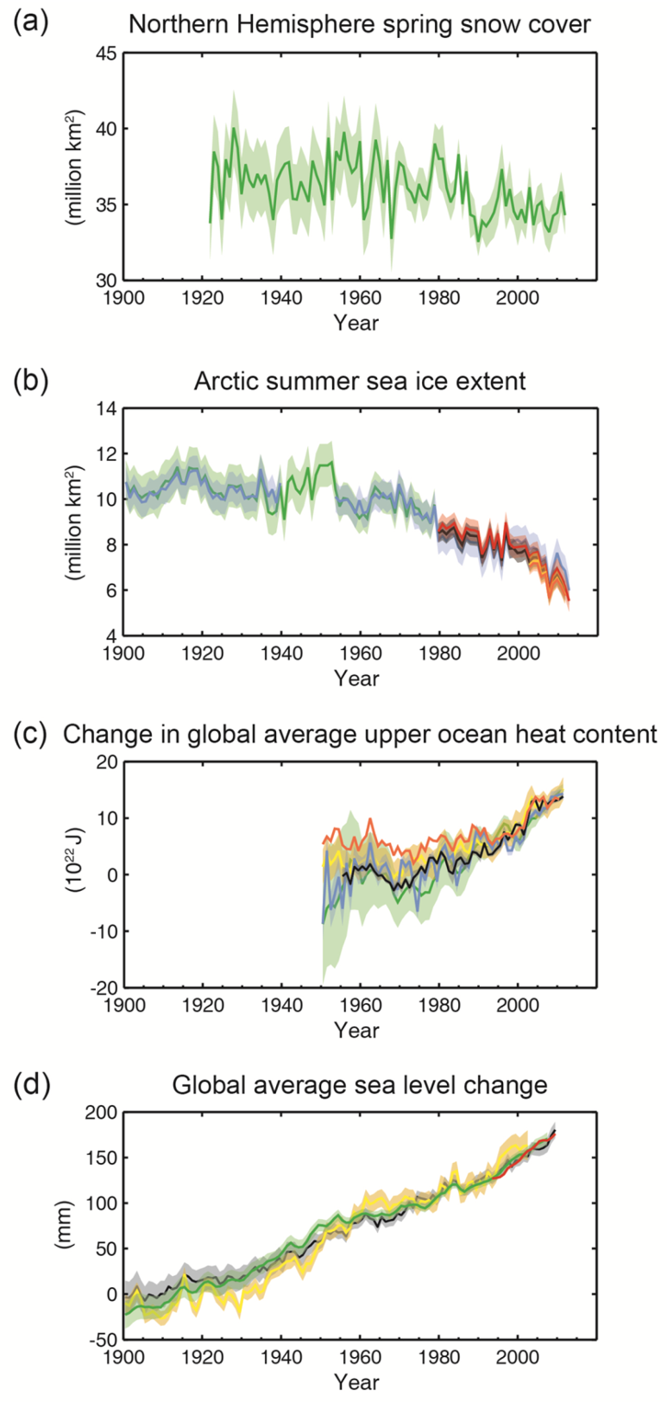
B.3 Cryosphere
Figure SPM.3: Multiple observed indicators of a changing global climate:
Extent of Northern Hemisphere March-April (spring) average snow cover,
Extent of Arctic July-August-September (summer) average sea ice,
(c) change in global mean upper ocean (0–700 m) heat content aligned to 2006−2010, and relative to the mean of all datasets for 1971,
(d) global mean sea level relative to the 1900–1905 mean of the longest running dataset, and with all datasets aligned to have the same value in 1993, the first year of satellite altimetry data.
Notes:
Figure SPM.3: Multiple observed indicators of a changing global climate: (a) Extent of Northern Hemisphere March-April (spring) average snow cover, (b) Extent of Arctic July-August-September (summer) average sea
ice, (c) change in global mean upper ocean (0–700 m) heat content aligned to 2006−2010, and relative to the mean of all datasets for 1971, (d) global mean sea level relative to the 1900–1905 mean of the longest
running dataset, and with all datasets aligned to have the same value in 1993, the first year of satellite altimetry data. All time-series (coloured lines indicating different data sets) show annual values, and where assessed, uncertainties are indicated by coloured shading.

Slide 13
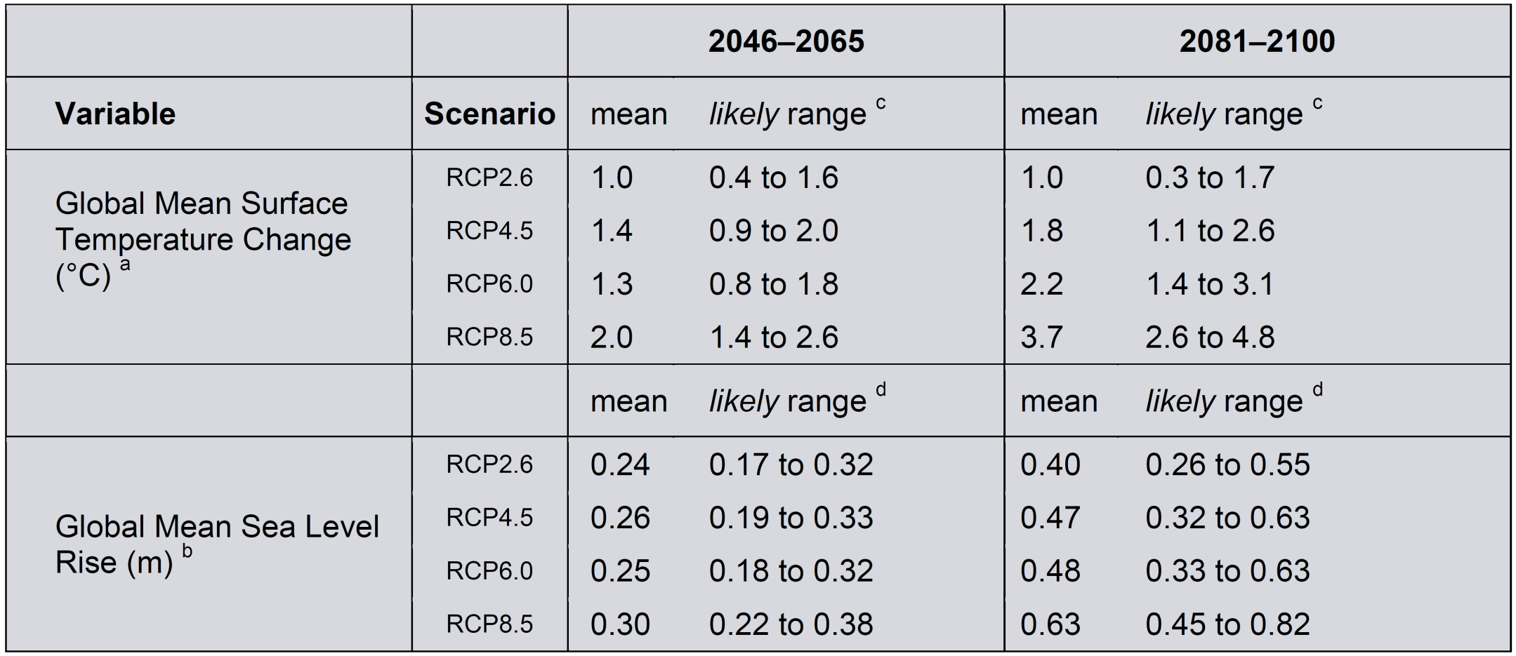
E. Future Global and Regional Climate Change
Table SPM.2: Projected change in global mean surface air temperature and global mean sea level rise for the mid- and late 21st century relative to the reference period of 1986–2005.
Notes:
Table SPM.2: Projected change in global mean surface air temperature and global mean sea level rise for the mid- and late 21st century relative to the reference period of 1986–2005.

Slide 14
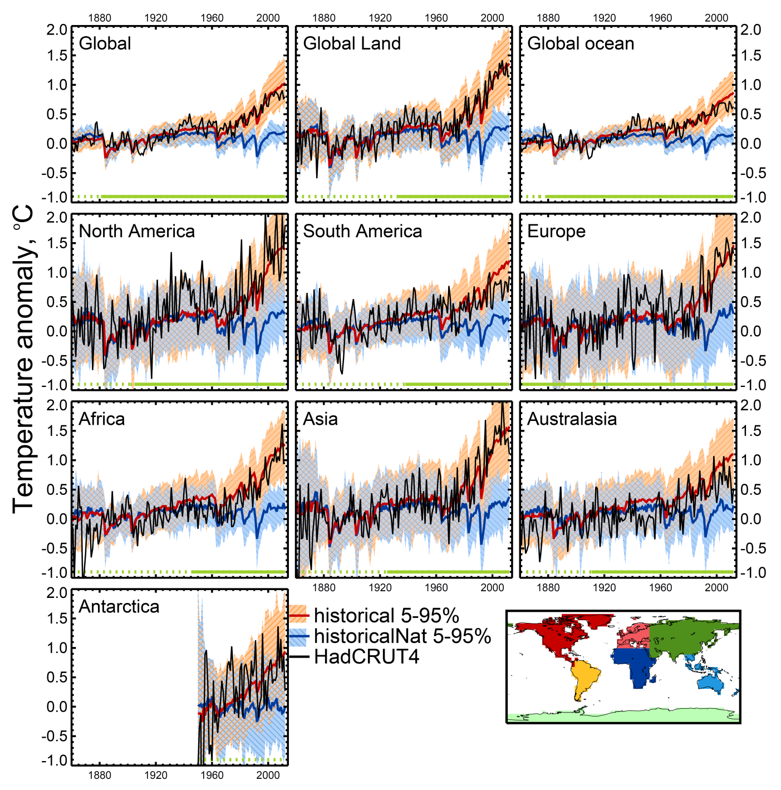
Figure 10.7: Global, land, ocean and continental annual mean temperatures for CMIP3 and CMIP5 historical (red) and historical Nat (blue) simulations (multi-model means shown as thick lines, and 5–95% ranges shown as thin light lines) and for HadCRUT4 (black).
Notes:
Figure 10.7: Global, land, ocean and continental annual mean temperatures for CMIP3 and CMIP5 historical (red) and historical Nat (blue) simulations (multi-model means shown as thick lines, and 5–95% ranges shown as thin light lines) and for HadCRUT4 (black). Mean temperatures are shown for Antarctica and six continental regions formed by combining the sub-continental scale regions defined by Seneviratne et al. (2012). Temperatures are shown with respect to 1880–1919 for all regions apart from Antarctica where temperatures are shown with respect to 1950–2010. Adapted from Jones et al. (2013 ).

Slide 15
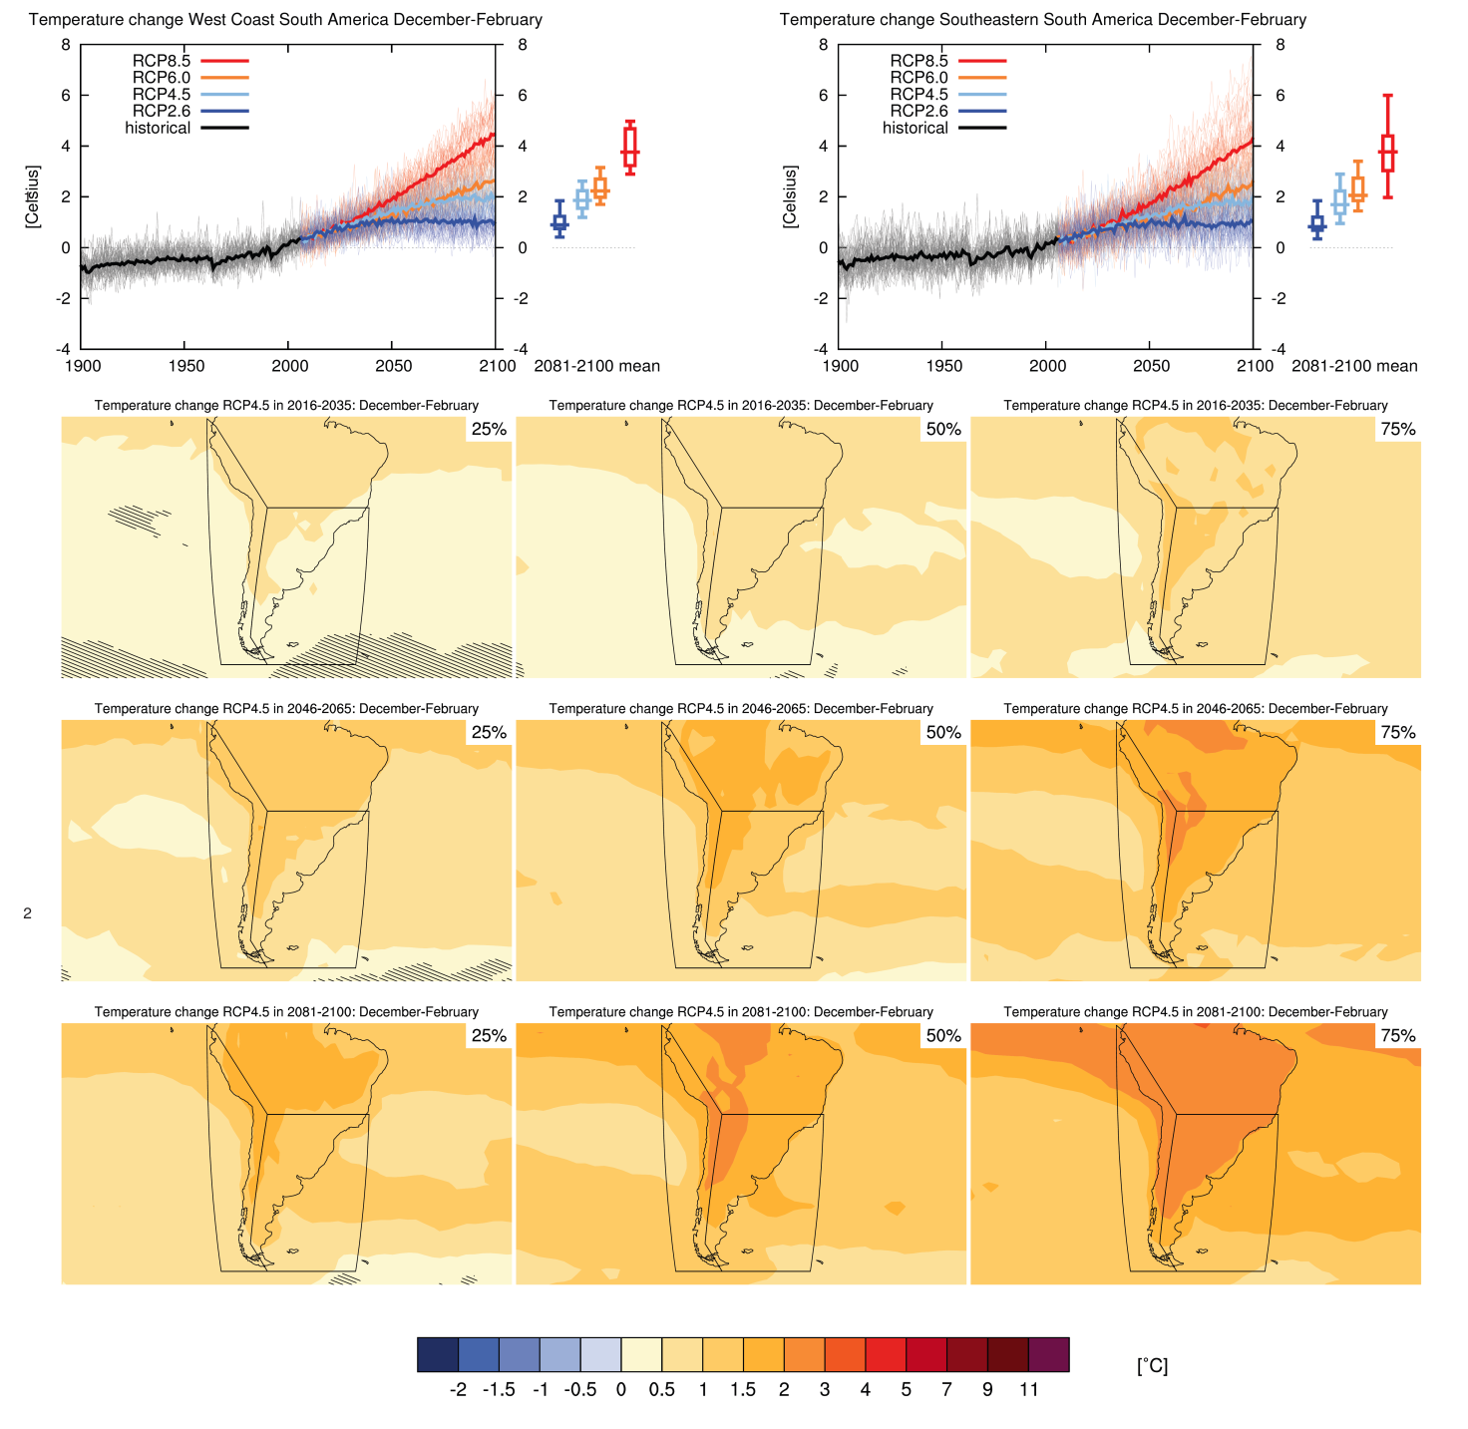
Climate Change in South America
Figure AI.32: Top 3 left: time series of temperature change relative to 1986–2005 averaged over land grid points in the West Coast of South America
in December–February.
Notes:
Figure AI.32: Top 3 left: time series of temperature change relative to 1986–2005 averaged over land grid points in theWest Coast of South America (79.7_W,1.2_S; 66.4_W,20_S; 72.1_W,50_S; 67.3_W56.7_S; 82.0_W 56.7_S; 82.2_W,0.5_N) in December–February. Top right: same for land grid points in Southeastern South America (39.4_W,20_S; 39.4_W,56.6_S; 67.3_W,56.7_S; 72.1_W,50_S; 66_W,20_S). Thin lines denote one en7 semble member per model, thick lines the CMIP5 multi-model mean. On the right-hand side the 5th, 25th, 50th (median), 75th and 95th percentiles of the distribution of 20-yr mean changes are given for 2081–2100 in the four RCP scenarios.
Below: maps of temperature changes in 2016–2035, 2046–2065 and 2081–2100 with respect to 1986–2005 in the RCP4.5 scenario. For each point, the 25th, 50th and 75th percentile of the distribution of the CMIP5 ensemble are shown, this includes both natural variability and inter-model spread. Hatching denotes areas where the 20-yr mean differences of the percentiles are less than the standard deviation of model-estimated present-day natural variability of 20-yr mean differences.

Slide 16
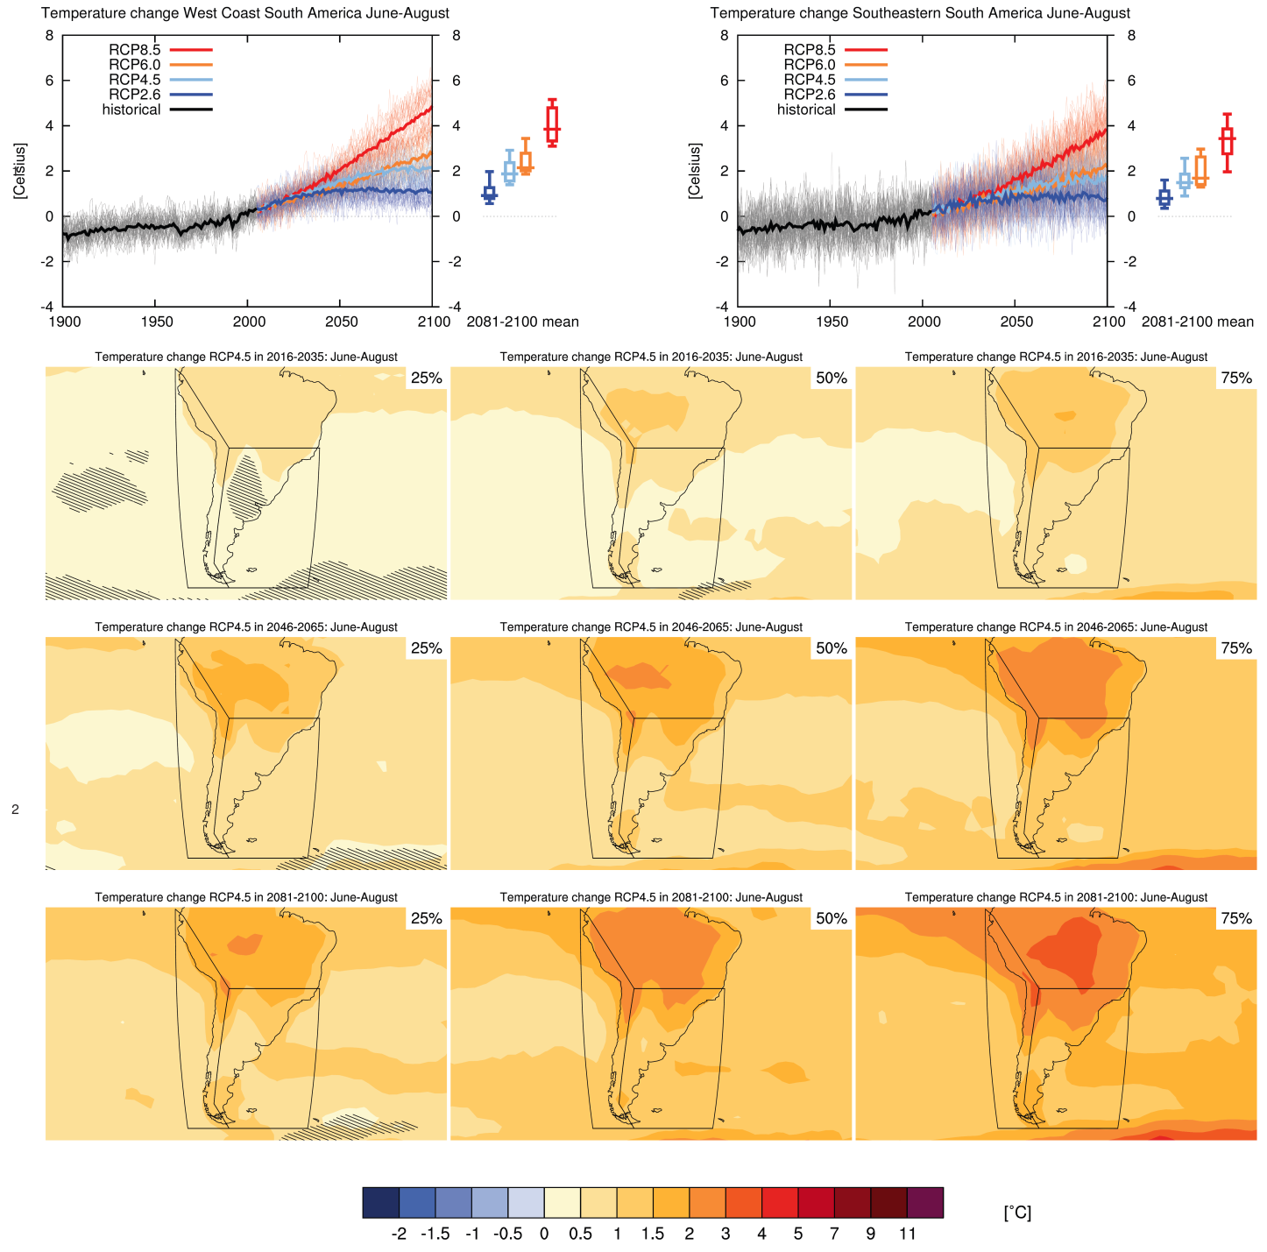
Climate Change in South America
Figure AI.33: Top 3 left: time series of temperature change relative to 1986–2005 averaged over land grid 4 points in theWest Coast of South America in June–August.
Notes:
Figure AI.33: Top 3 left: time series of temperature change relative to 1986–2005 averaged over land grid 4 points in theWest Coast of South America (79.7W,1.2S; 66.4W,20S; 72.1W,50S; 67.3W56.7S; 82.0W 56.7S; 82.2W,0.5N) in June–August. Top right: same for land grid points in Southeastern South America (39.4W,20S; 39.4W,56.6S; 67.3W,56.7S; 72.1W,50S; 66W,20S). Thin lines denote one ensemble member per model, thick lines the CMIP5 multi-model mean. On the right-hand side the 5th, 25th, 50th (median), 75th and 95th percentiles of the distribution of 20-yr mean changes are given for 2081–2100 in the four RCP scenarios.
Below: maps of temperature changes in 2016–2035, 2046–2065 and 2081–2100 with respect to 1986–2005 in the RCP4.5 scenario. For each point, the 25th, 50th and 75th percentile of the distribution of the CMIP5 ensemble are shown, this includes both natural variability and inter-model spread. Hatching denotes areas where the 20-yr mean differences of the percentiles are less than the standard deviation of model-estimated present-day natural variability of 20-yr mean differences.

Slide 17
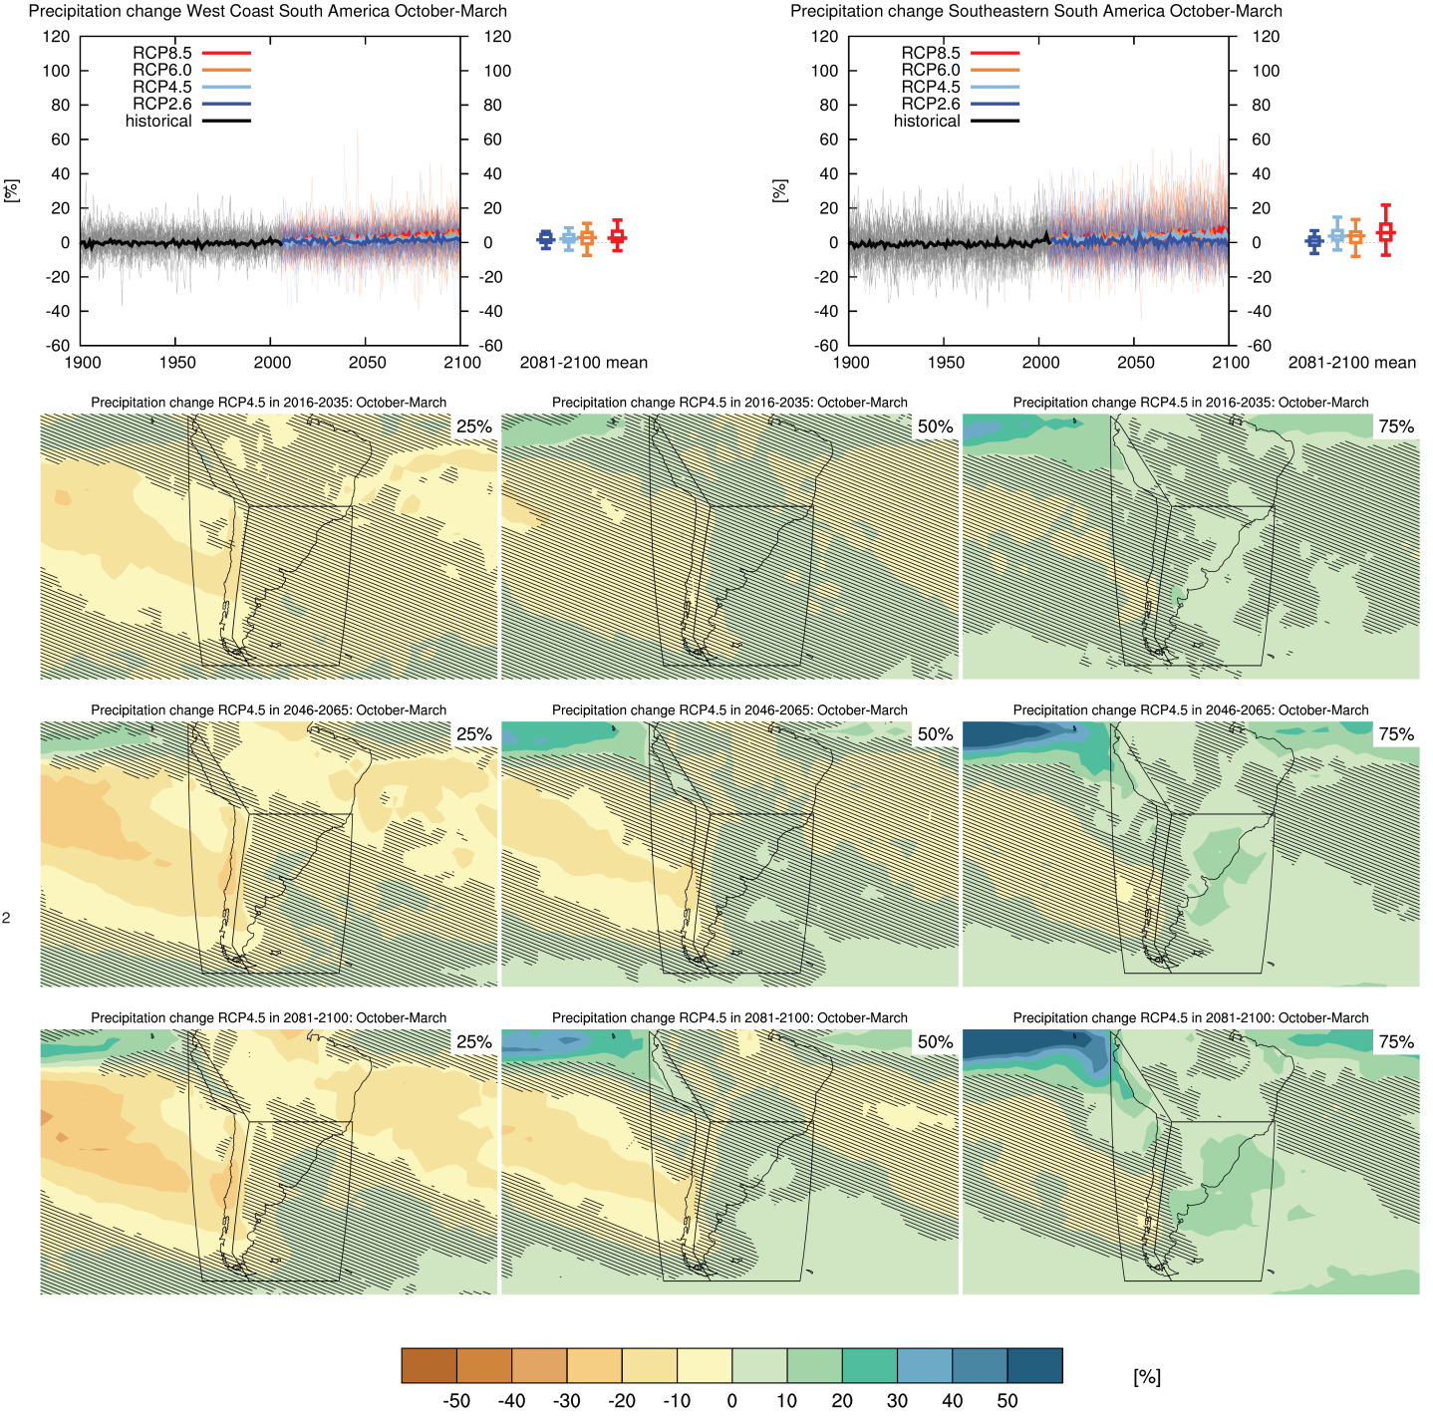
Climate Change in South America
Figure AI.34: Top left: time 3 series of relative change relative to 1986–2005 in precipitation averaged over land grid points in the West Coast of South America in October–March.
Notes:
Figure AI.34: Top left: time 3 series of relative change relative to 1986–2005 in precipitation averaged over land grid points in the West Coast of South America (79.7W,1.2S; 66.4W,20S; 72.1W,50S; 67.3W56.7S; 82.0W 56.7S; 82.2W,0.5N) in October–March. Top right: same for land grid points in Southeastern South America (39.4W,20S; 39.4W,56.6S; 67.3W,56.7S; 72.1W,50S; 66W,20S). Thin lines denote one en7 semble member per model, thick lines the CMIP5 multi-model mean. On the right-hand side the 5th, 25th, 50th (median), 75th and 95th percentiles of the distribution of 20-yr mean changes are given for 2081–2100 in the four RCP scenarios.
Below: maps of precipitation changes in 2016–2035, 2046–2065 and 2081–2100 with respect to 1986–2005 in the RCP4.5 scenario. For each point, the 25th, 50th and 75th percentile of the distribution of the CMIP5 ensemble are shown, this includes both natural variability and inter-model spread. Hatching denotes areas where the 20-yr mean differences of the percentiles are less than the standard deviation of model-estimated present-day natural variability of 20-yr mean differences.

Slide 18
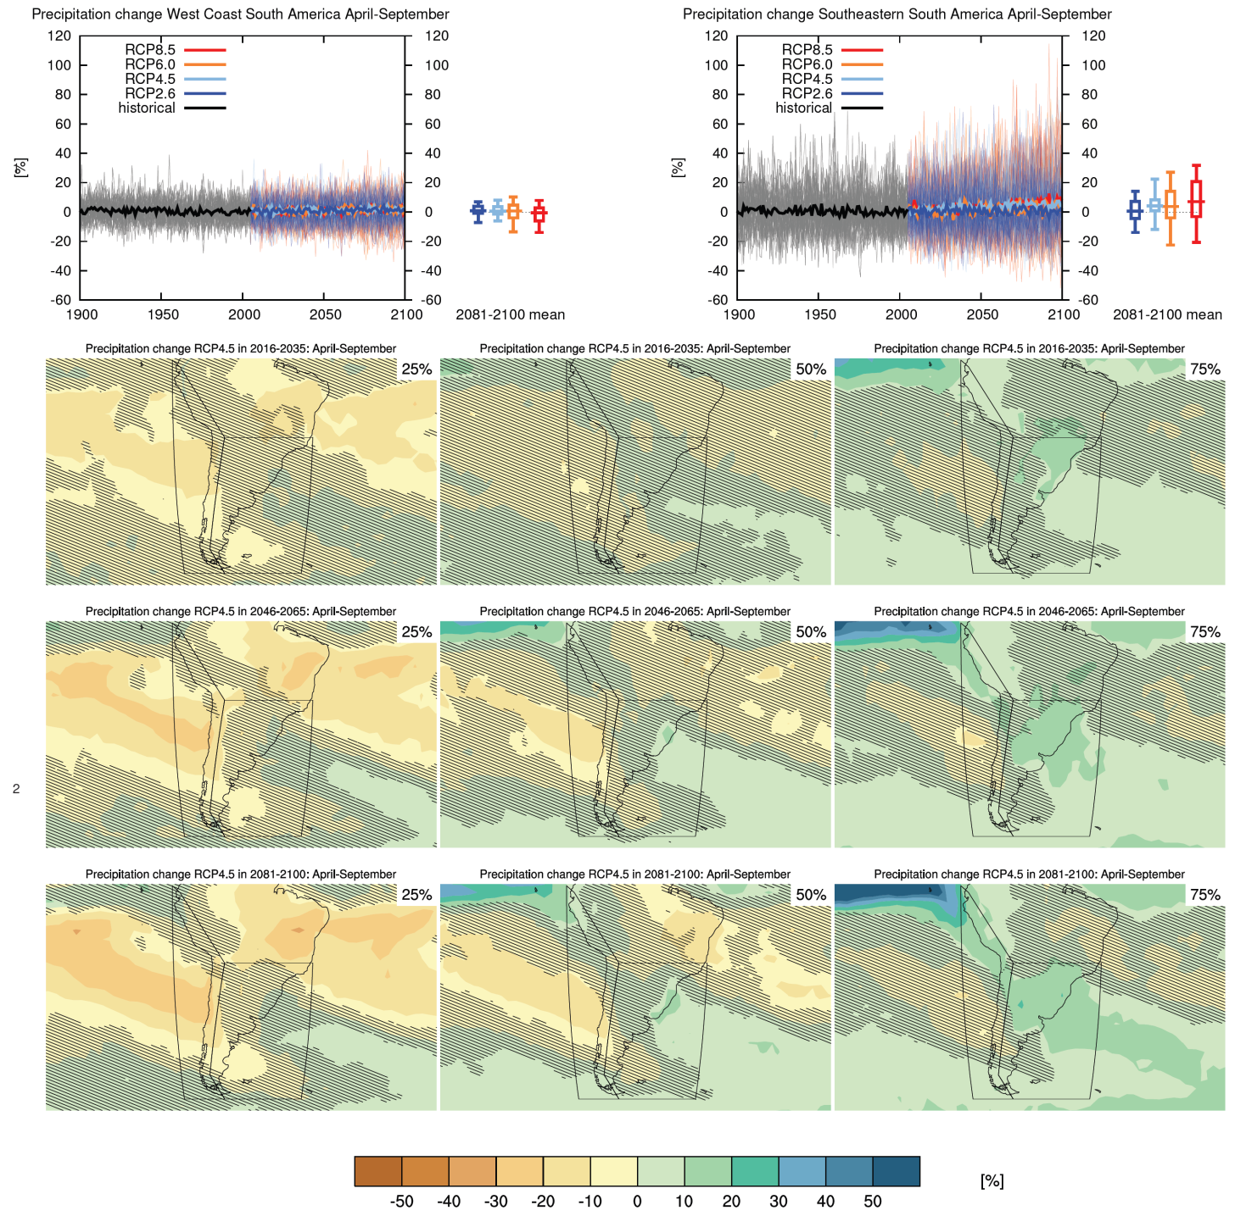
Climate Change in South America
Figure AI.35: Top left: time 3 series of relative change relative to 1986–2005 in precipitation averaged over land grid points in the West Coast of South America in April–September.
Notes:
Figure AI.35: Top left: time 3 series of relative change relative to 1986–2005 in precipitation averaged over land grid points in the West Coast of South America (79.7W,1.2S; 66.4W,20S; 72.1W,50S; 67.3W56.7S; 82.0W 56.7S; 82.2W,0.5N) in April–September. Top right: same for land grid points in Southeastern South America (39.4W,20S; 39.4W,56.6S; 67.3W,56.7S; 72.1W,50S; 66W,20S). Thin lines denote one ensemble member per model, thick lines the CMIP5 multi-model mean. On the right-hand side the 5th, 25th, 50th (median), 75th and 95th percentiles of the distribution of 20-yr mean changes are given for 2081–2100 in the four RCP cenarios. Below: maps of precipitation changes in 2016–2035, 2046–2065 and 2081–2100 with respect to 1986–2005 in the RCP4.5 scenario. For each point, the 25th, 50th and 75th percentile of the distribution of the CMIP5 ensemble are shown, this includes both natural variability and inter-model spread. Hatching denotes areas where the 20-yr mean differences of the percentiles are less than the standard deviation of model-estimated resent-day natural variability of 20-yr mean differences.

Slide 19
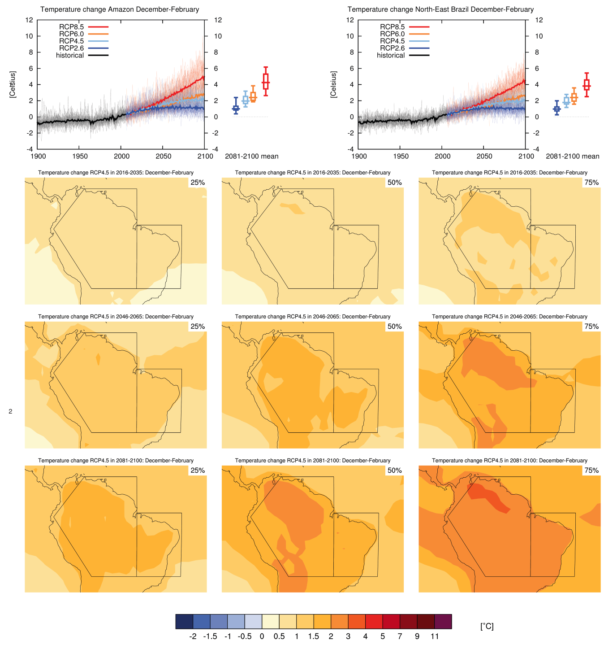
Climate Change in South America
Figure AI.28: Top 3 left: time series of temperature change relative to 1986–2005 averaged over land grid points in the Amazon in December– February.
Notes:
Figure AI.28: Top 3 left: time series of temperature change relative to 1986–2005 averaged over land grid points in the Amazon (20S,66.4W; 1.24S,79.7W; 11.4S,68.8W; 11.44S,50W; 20S,50W) in December– February. Top right: same for land grid points in North-East Brazil (20S–EQ, 50–34W). Thin lines de note one ensemble member per model, thick lines the CMIP5 multi-model mean. On the right-hand side the 5th, 25th, 50th (median), 75th and 95th percentiles of the distribution of 20-yr mean changes are given for 2081–2100 in the four RCP scenarios.
Below: maps of temperature changes in 2016–2035, 2046–2065 and 2081–2100 with respect to 1986–2005 in the RCP4.5 scenario. For each point, the 25th, 50th and 75th percentile of the distribution of the CMIP5 ensemble are shown, this includes both natural variability and inter-model spread. Hatching denotes areas where the 20-yr mean differences of the percentiles are less than the standard deviation of model-estimated present-day natural variability of 20-yr mean differences.

Slide 20
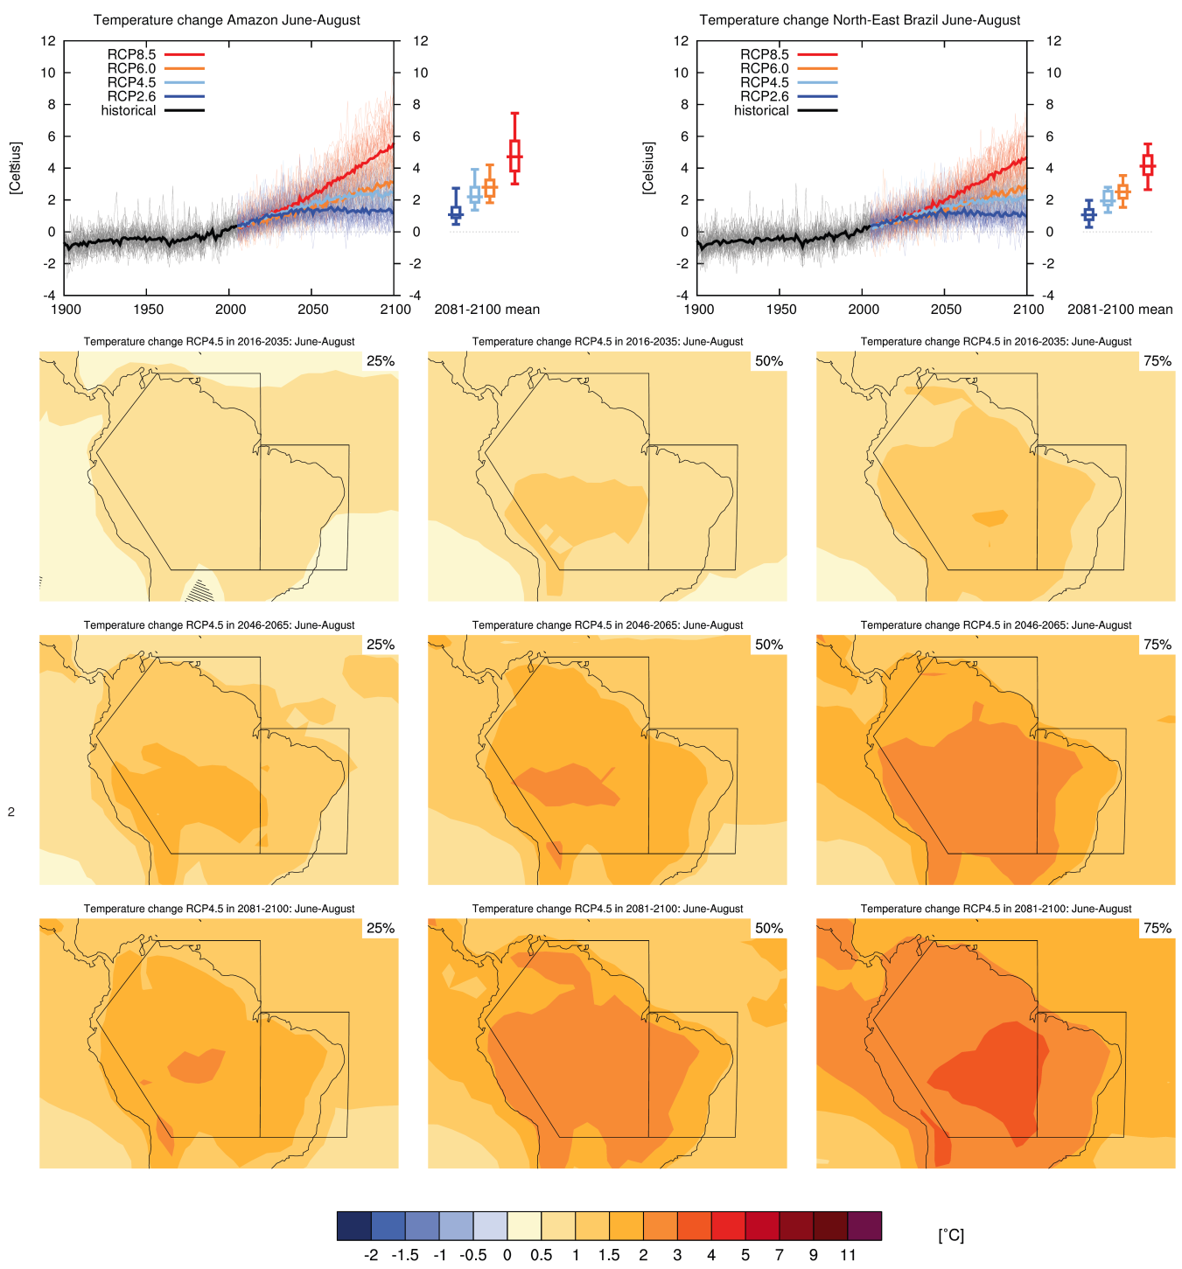
Climate Change in South America
Figure AI.29: Top 3 left: time series of temperature change relative to 1986–2005 averaged over land grid points in the Amazon in June–August.
Notes:
Figure AI.29: Top 3 left: time series of temperature change relative to 1986–2005 averaged over land grid points in the Amazon (20S,66.4W; 1.24S,79.7W; 11.4S,68.8W; 11.44S,50W; 20S,50W) in June–August. Top right: same for land grid points in North-East Brazil (20S–EQ, 50–34W). Thin lines denote one ensemble member per model, thick lines the CMIP5 multi-model mean. On the right-hand side the 5th, 25th, 50th (median), 75th and 95th percentiles of the distribution of 20-yr mean changes are given for 2081– 2100 in the four RCP scenarios.
Below: maps of temperature changes in 2016–2035, 2046–2065 and 2081–2100 with respect to 1986–2005 in the RCP4.5 scenario. For each point, the 25th, 50th and 75th percentile of the distribution of the CMIP5 ensemble are shown, this includes both natural variability and inter-model spread. Hatching denotes areas where the 20-yr mean differences of the percentiles are less than the standard deviation of model-estimated present-day natural variability of 20-yr mean differences.

Slide 21
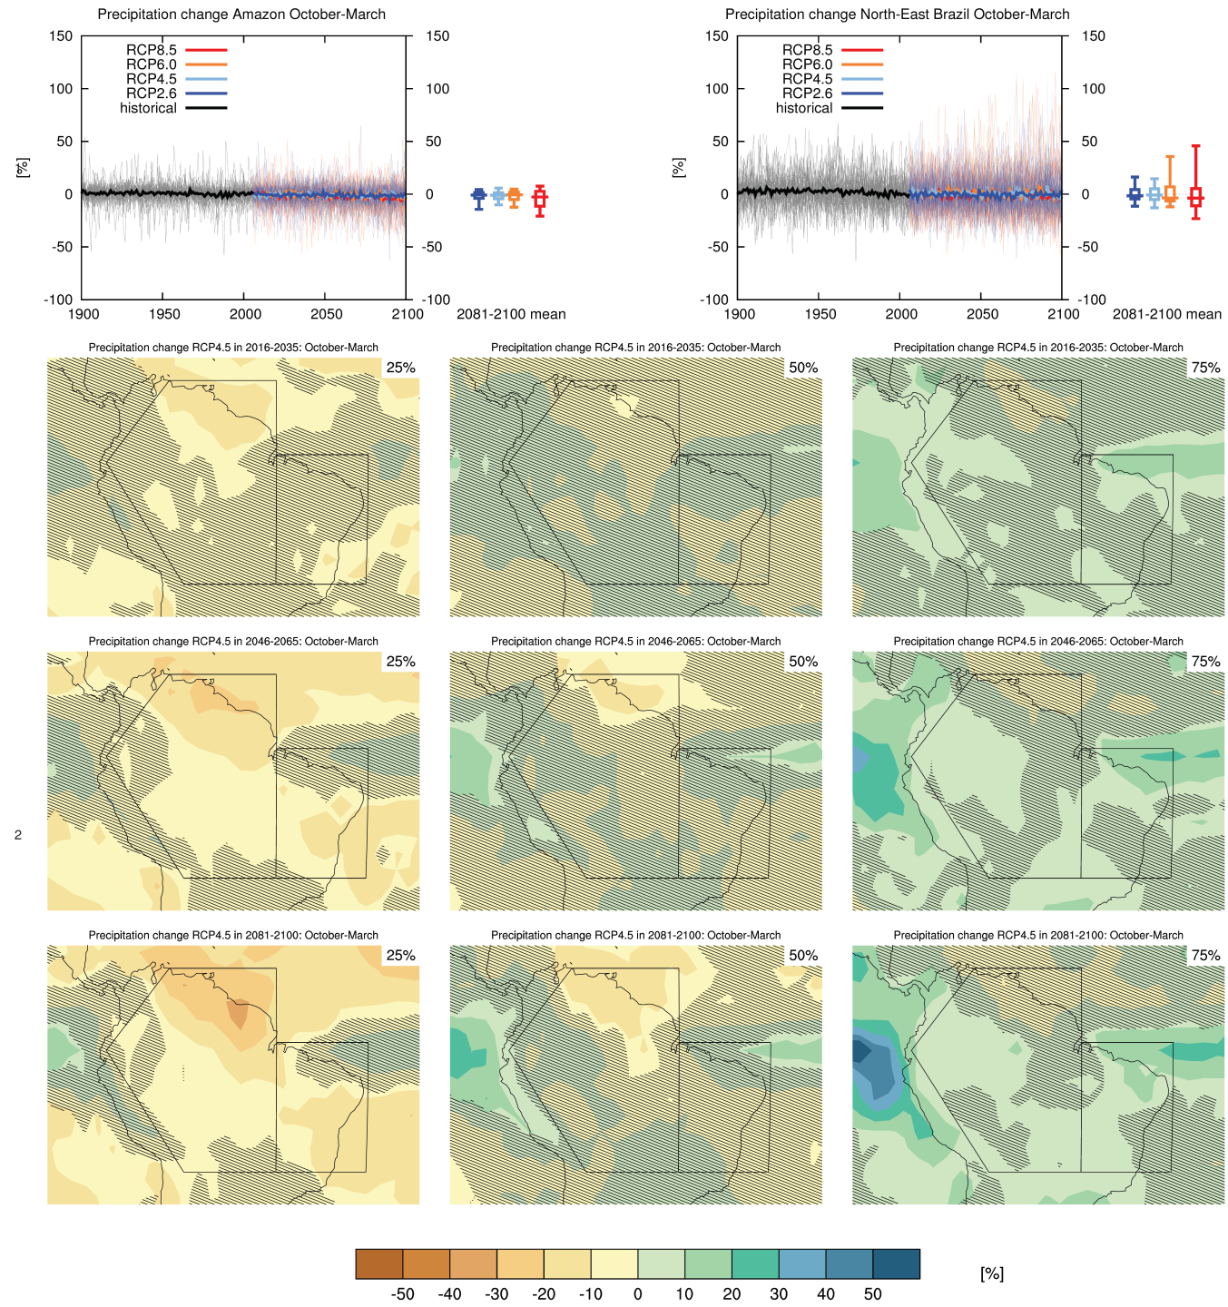
Climate Change in South America
Figure AI.30: Top left: time 3 series of relative change relative to 1986–2005 in precipitation averaged over land grid points in the Amazon in October–March.
Notes:
Figure AI.30: Top left: time 3 series of relative change relative to 1986–2005 in precipitation averaged over land grid points in the Amazon (20S,66.4W; 1.24S,79.7W; 11.4S,68.8W; 11.44S,50W; 20S,50W) in October–March. Top right: same for land grid points in North-East Brazil (20S–EQ, 50–34W). Thin lines denote one ensemble member per model, thick lines the CMIP5 multi-model mean. On the right-hand side the 5th, 25th, 50th (median), 75th and 95th percentiles of the distribution of 20-yr mean changes are given for 2081–2100 in the four RCP scenarios.
Below: maps of precipitation changes in 2016–2035, 2046–2065 and 2081–2100 with respect to 1986–2005 in the RCP4.5 scenario. For each point, the 25th, 50th and 75th percentile of the distribution of the CMIP5 ensemble are shown, this includes both natural variability and inter-model spread. Hatching denotes areas where the 20-yr mean differences of the percentiles are less than the standard deviation of model-estimated present-day natural variability of 20-yr mean differences.

Slide 22
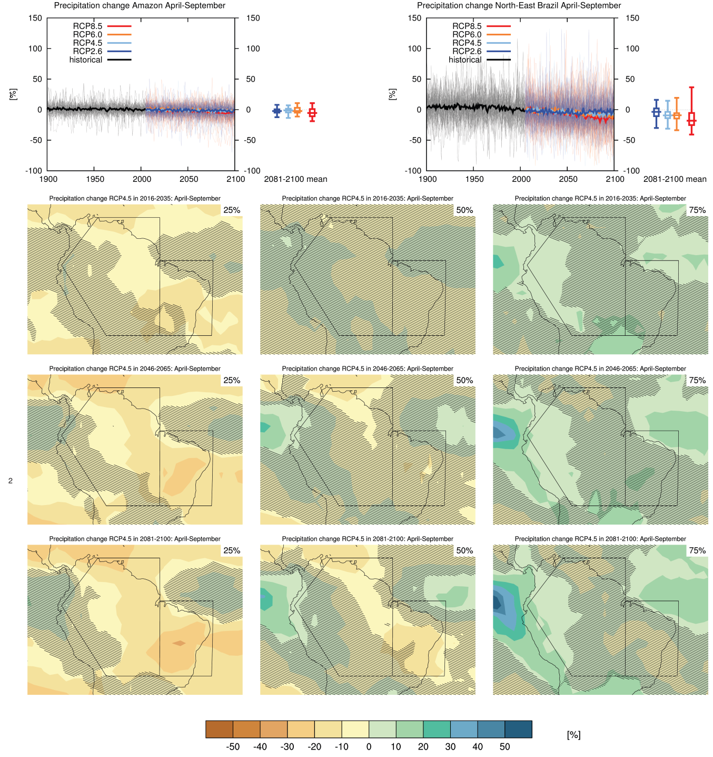
Climate Change in South America
Figure AI.31: Top left: time 3 series of relative change relative to 1986–2005 in precipitation averaged over land grid points in the Amazon in April– September.
Notes:
Figure AI.31: Top left: time 3 series of relative change relative to 1986–2005 in precipitation averaged over land grid points in the Amazon (20S,66.4W; 1.24S,79.7W; 11.4S,68.8W; 11.44S,50W; 20S,50W) in April– September. Top right: same for land grid points in North-East Brazil (20S–EQ, 50–34W). Thin lines denote one ensemble member per model, thick lines the CMIP5 multi-model mean. On the right-hand side the 5th, 25th, 50th (median), 75th and 95th percentiles of the distribution of 20-yr mean changes are given for 2081–2100 in the four RCP scenarios.
Below: maps of precipitation changes in 2016–2035, 2046–2065 and 2081–2100 with respect to 1986–2005 in the RCP4.5 scenario. For each point, the 25th, 50th and 75th percentile of the distribution of the CMIP5 ensemble are shown, this includes both natural variability and inter-model spread. Hatching denotes areas where the 20-yr mean differences of the percentiles are less than the standard deviation of model-estimated present-day natural variability of 20-yr mean differences.

Slide 23
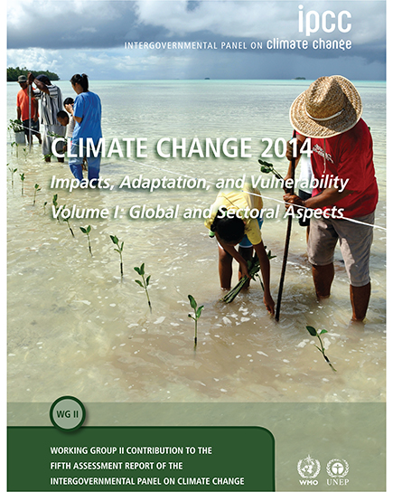

Slide 24
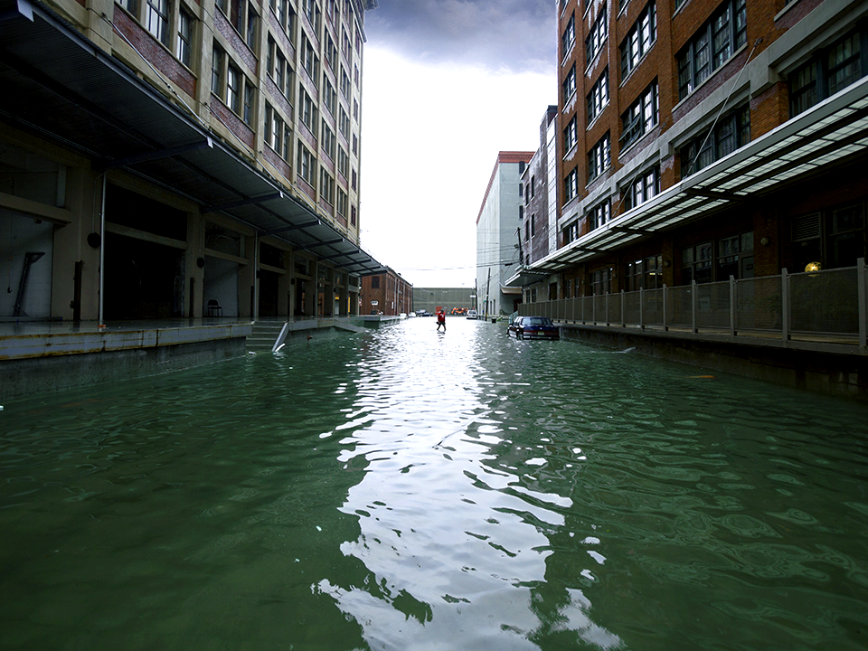
KEY MESSAGES
• Climate change is already causing harm.
• The more we warm the climate the more risks we will face including the possibility of irreversible damage.
• Effective and inclusive climate-change adaptation can help build a richer more resilient world n the near-term and beyond.

Slide 25
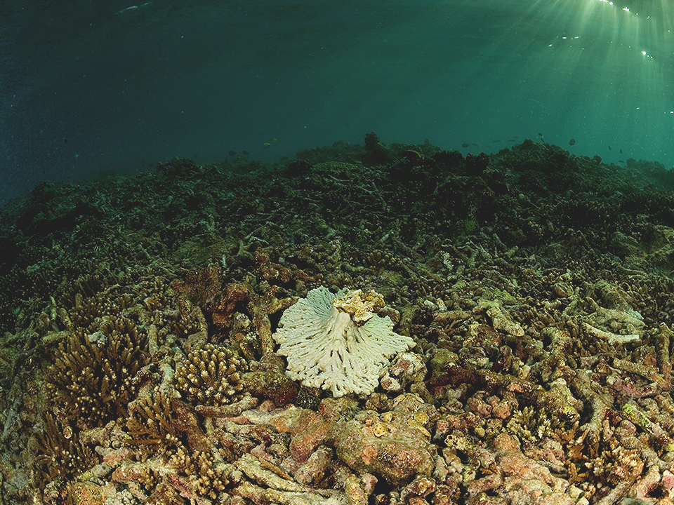
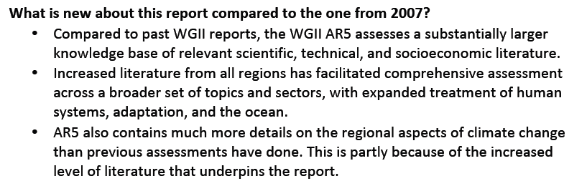


Slide 26
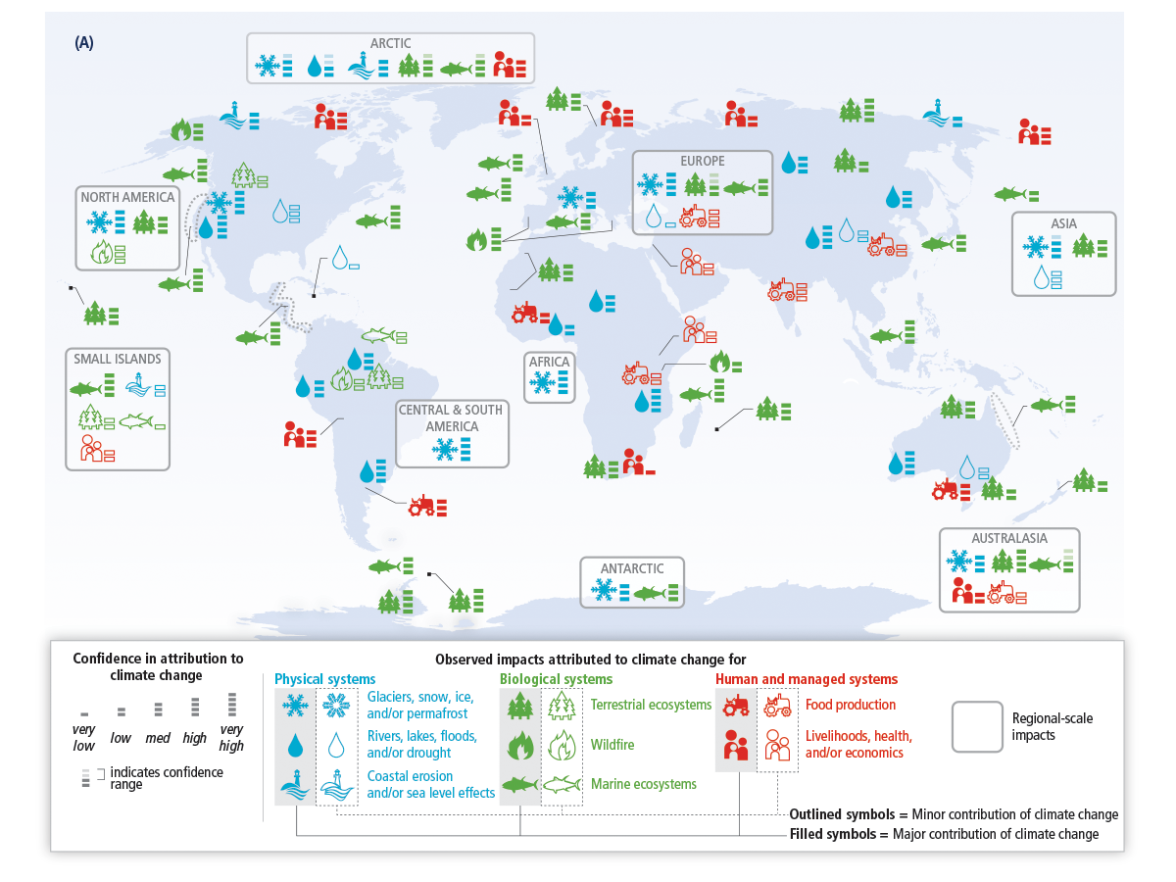
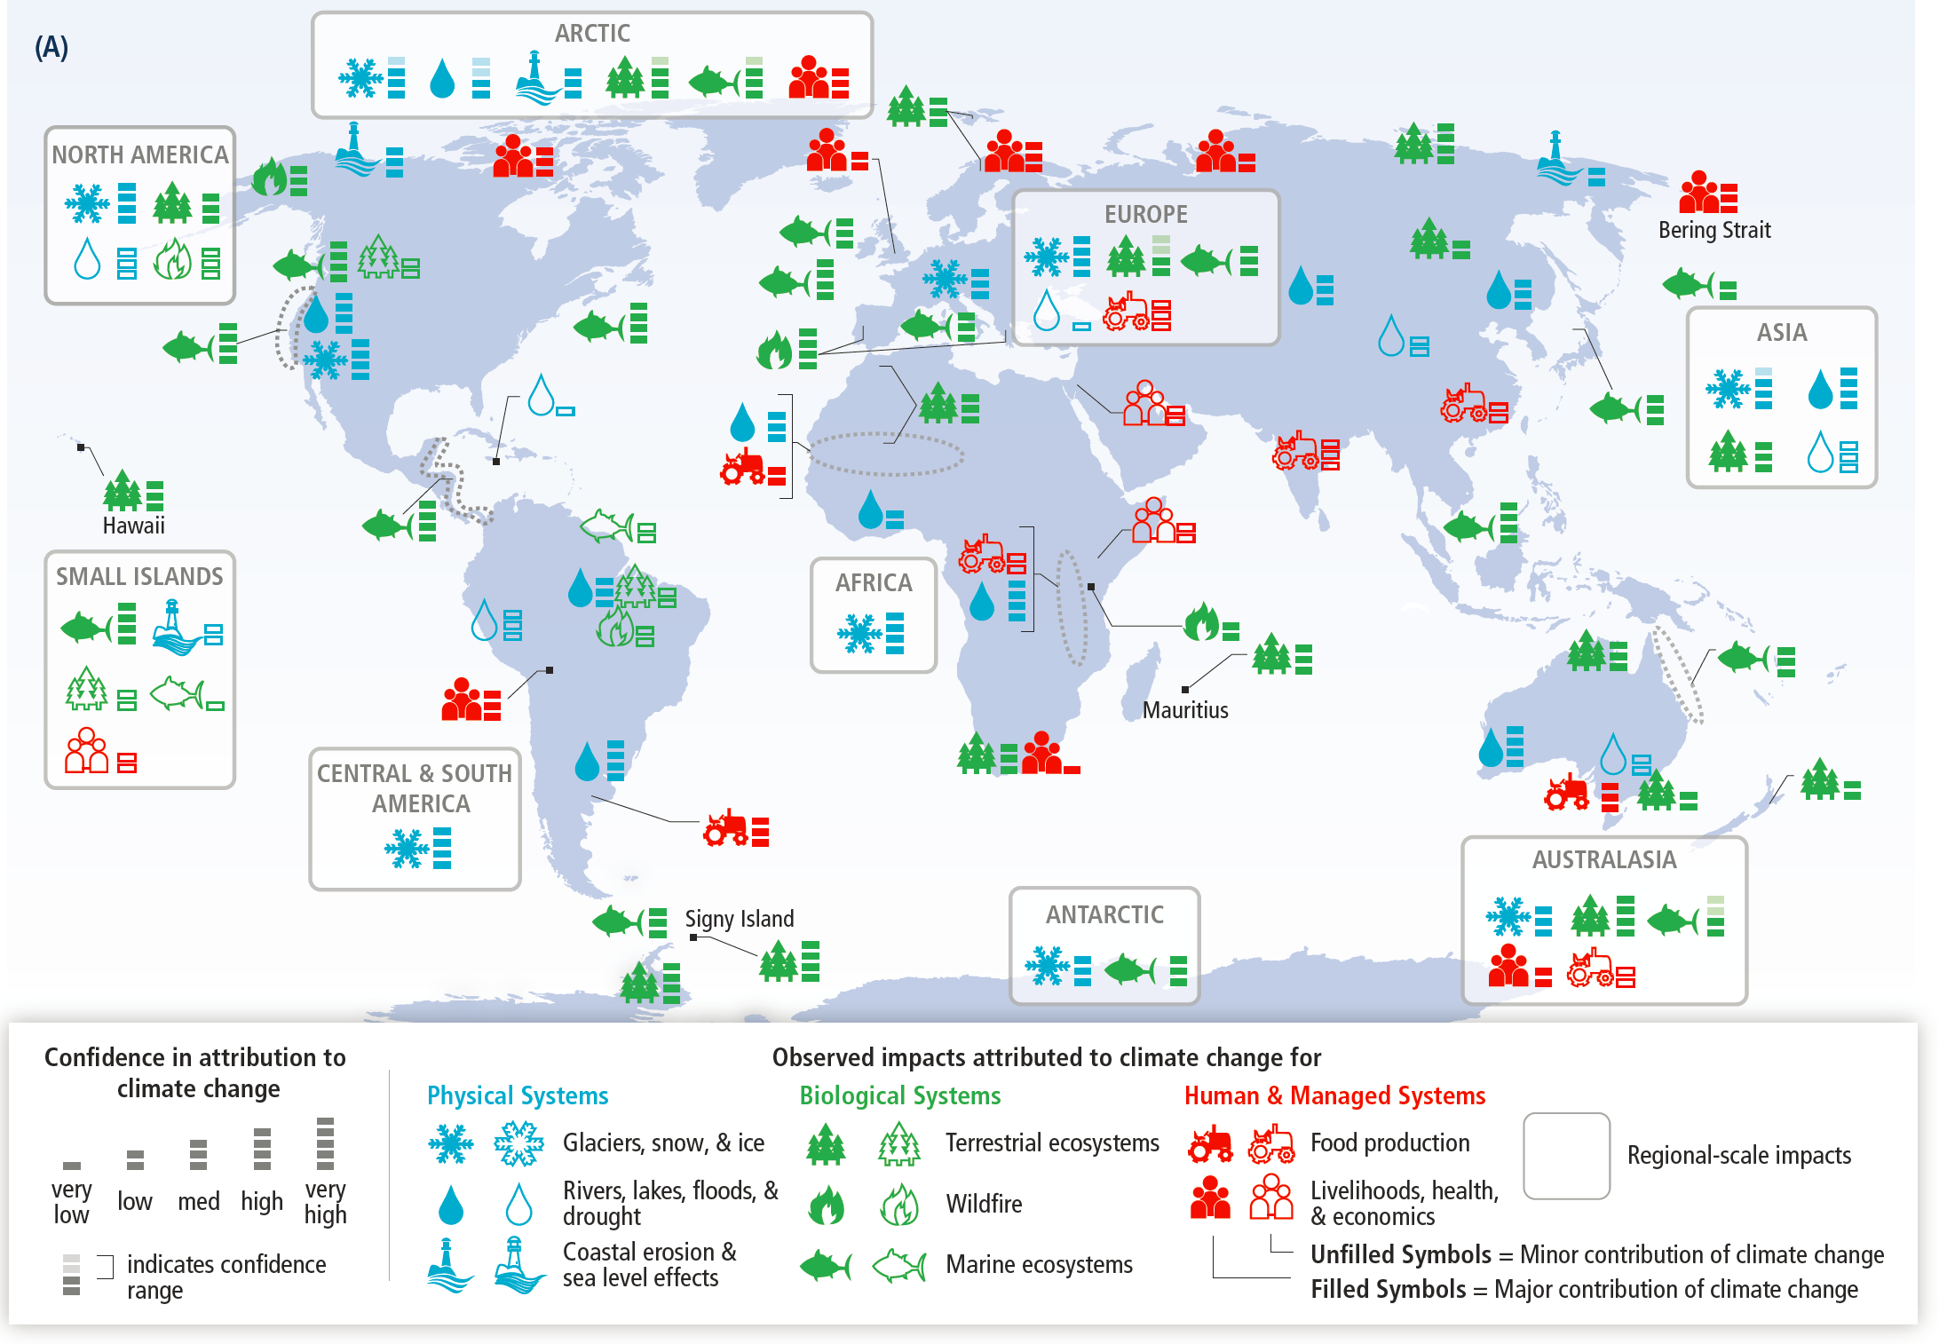
Global patterns of impacts in recent decades attributed to climate change, based on studies since the AR4. Impacts are shown at a range of geographic scales.

Slide 28
Summary of estimated impacts of observed climate changes on yields over 1960-2013 for four major crops in temperate and tropical regions.
2
0
-2
-4
90th Percentile
YIELD IMPACT
(% Change per Decade)
75th Percentile
-6
Median
25th Percentile
Wheat
Soy
Rice
Maize
10th Percentile
CROP TYPE

Slide 29
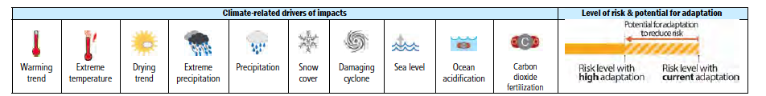
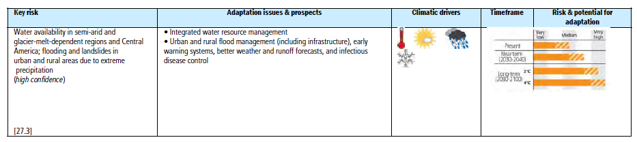
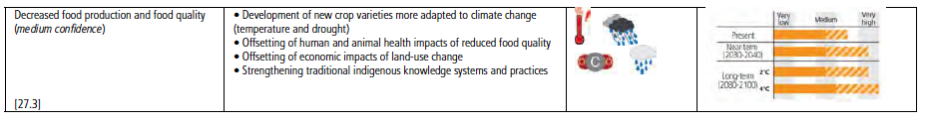
Central and South America could see increased risks to human health, problems with water availability in some regions, and flooding and landslides due to extreme precipitation in others, and decreased food production and quality.

Slide 30
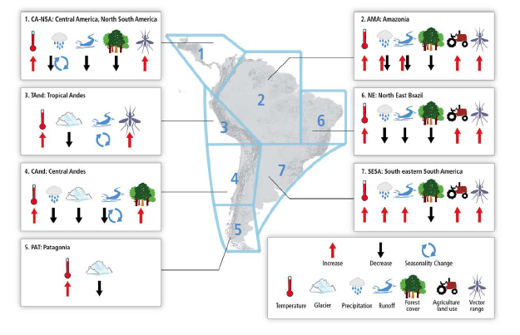
Summary of observed changes in climate and other environmental factors in representative regions of CA and SA. The boundaries of the regions in the map are conceptual (neither geographic nor political precision).

Slide 31
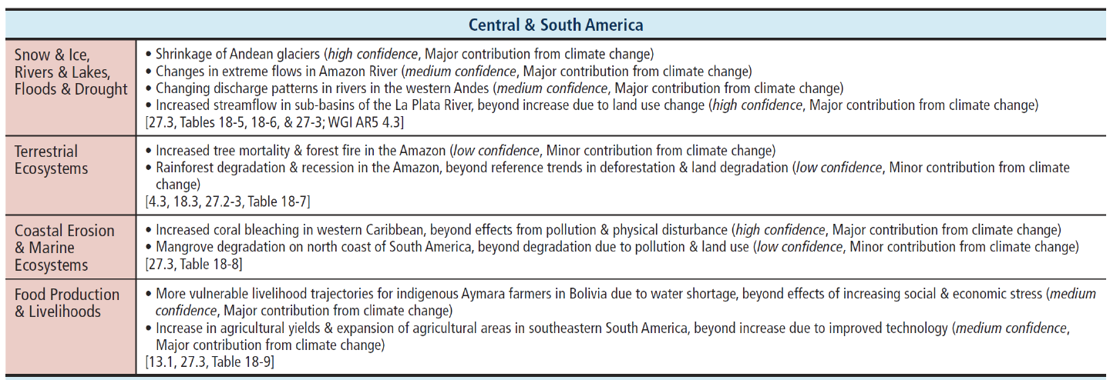
Observed impacts attributed to climate change reported in the scientific literature
since the AR4. These impacts have been attributed to climate change with very low, low, medium, or high confidence, with the relative contribution of climate change to the observed change indicated (major or minor), for natural and human systems across eight major world regions over the past several decades.

Slide 32
Significant trends in precipitation and temperature have been observed in CA and SA (high confidence ). Besides, changes in climate variability and in extreme events have severely
affected the region (medium confidence ).
Climate projections suggest increases in temperature, and increases or decreases in precipitation for CA and SA by 2100 (medium confidence ).
Changes in stream flow and water availability have been observed and projected to continue in the future in CA and SA, affecting already vulnerable regions (high confidence ).
Land use change contributes significantly to environmental degradation exacerbating the negative impacts of climate change (high confidence ).
Conversion of natural ecosystems is the main cause of biodiversity and ecosystem loss in the region, and is a driver of anthropogenic CC (high confidence ).
Sea-level rise (SLR) and human activities on coastal and marine ecosystems pose threats to fish stocks, corals, mangroves, recreation and tourism, and control of diseases (high confidence ).
Changes in agricultural productivity with consequences for food security associated to CC are expected to exhibit large spatial variability (medium confidence ).
In many CA and SA countries, a first step toward adaptation to future climate changes is o reduce the vulnerability to present climate.

Slide 33
Principles for Effective Adaptation
Adaptation is place and context specific, with no single approach for reducing risks
appropriate across all settings (high confidence).
Adaptation planning and implementation can be enhanced through complementary actions
across levels, from individuals to governments (high confidence).
A first step towards adaptation to future climate change is reducing vulnerability and
exposure to present climate variability (high confidence). Strategies include actions with cobenefits for other objectives.
Adaptation planning and implementation at all levels of governance are contingent on
societal values, objectives, and risk perceptions (high confidence). Recognition of diverse
interests, circumstances, social-cultural contexts and expectations can benefit decision making
processes.
Existing and emerging economic instruments can foster adaptation by providing incentives
for anticipating and reducing impacts (medium confidence). Constraints can interact to impede adaptation planning and implementation (high confidence).
Poor planning, overemphasizing short-term outcomes, or failing to sufficiently anticipate
consequences can result in maladaptation (medium evidence, high agreement).

Slide 34
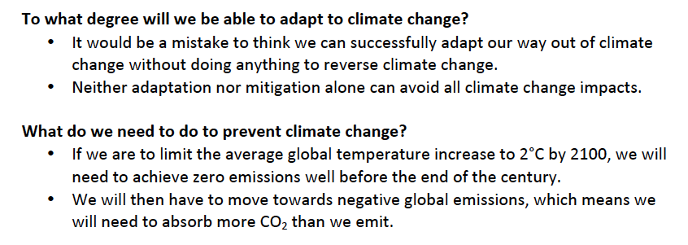

Slide 35
O MCTI e ações relacionadas à mudança do clima

Slide 36
Regime Internacional de
Mudança do Clima
Convenção Quadro das Nações Unidas sobre Mudança do Clima
Protocolo de Quioto
O regime diferencia obrigações de países desenvolvidos e não desenvolvidos.
O Brasil não possui meta de reduções sob a Convenção.
Objetivo do Regime: estabilização de concentrações atmosféricas de GEE que impeça interferência antrópica, perigosa, no sistema climático.
Notes:
Figure AI.33: Top 3 left: time series of temperature change relative to 1986–2005 averaged over land grid 4 points in theWest Coast of South America (79.7W,1.2S; 66.4W,20S; 72.1W,50S; 67.3W56.7S; 82.0W 56.7S; 82.2W,0.5N) in June–August. Top right: same for land grid points in Southeastern South America (39.4W,20S; 39.4W,56.6S; 67.3W,56.7S; 72.1W,50S; 66W,20S). Thin lines denote one ensemble member per model, thick lines the CMIP5 multi-model mean. On the right-hand side the 5th, 25th, 50th (median), 75th and 95th percentiles of the distribution of 20-yr mean changes are given for 2081–2100 in the four RCP scenarios.
Below: maps of temperature changes in 2016–2035, 2046–2065 and 2081–2100 with respect to 1986–2005 in the RCP4.5 scenario. For each point, the 25th, 50th and 75th percentile of the distribution of the CMIP5 ensemble are shown, this includes both natural variability and inter-model spread. Hatching denotes areas where the 20-yr mean differences of the percentiles are less than the standard deviation of model-estimated present-day natural variability of 20-yr mean differences.

Slide 37
Compromissos do Brasil
Elaborar inventários nacionais de emissão de GEE;
Formular programas contendo medidas de adaptação e mitigação;
Promover cooperação tecnológica;
Promover manejo sustentável de fontes e sumidouros de GEE;
Comunicações à UNFCCC

Slide 38
Política Brasileira
12/2008 – Plano Nacional de Mudança do Clima;
12/2009 – Política Nacional sobre Mudança do Clima;
12/2010 – Regulamentação da Lei que instituiu a Política Nacional estabelecendo critérios para elaboração de planos de prevenção e controle de desmatamentos e Planos Setoriais.

Slide 39
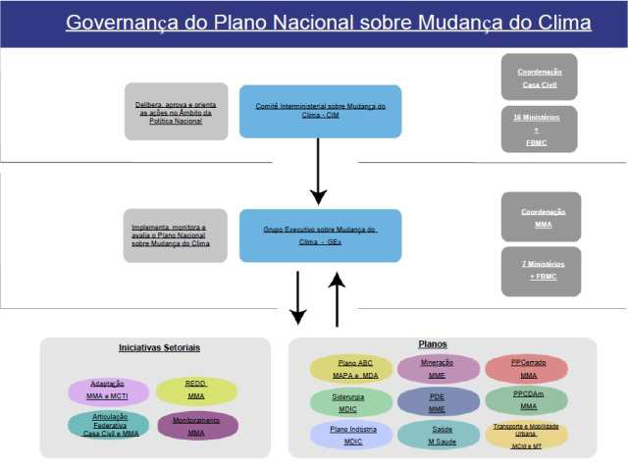

Slide 40
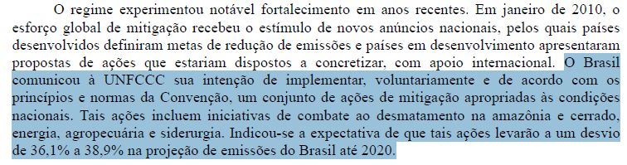

Slide 41
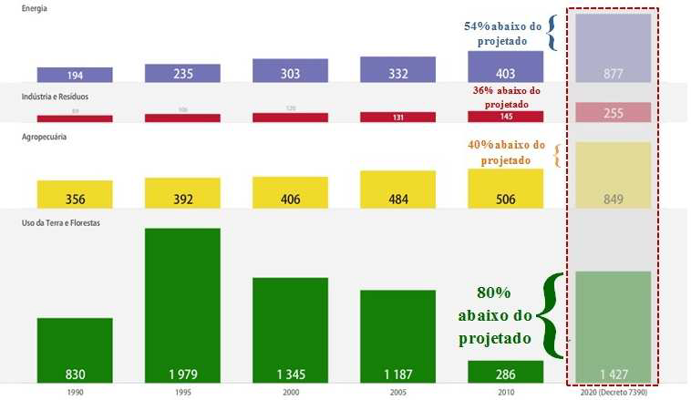
Total de emissões em 2010 é 60,7% inferior ao projetado para 2020

Slide 42
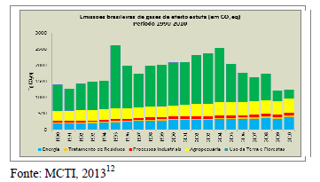
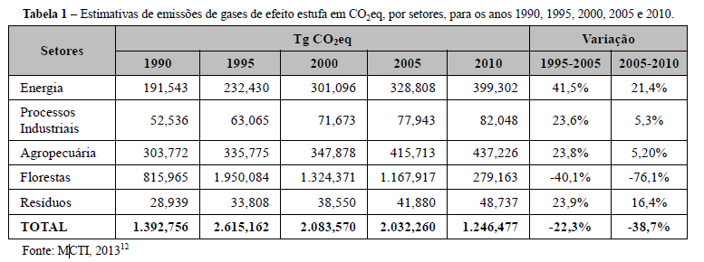

Slide 43
Implementação da Convenção-Quadro das Nações Unidas sobre Mudança do Clima (CQNUMC)
  Elaboração da Comunicação Nacional:
    Inventários nacionais de emissões antrópicas por fontes e das remoções por sumidouros de todos os gases de efeito estufa não controlados pelo Protocolo de Montreal;
    Medidas tomadas ou previstas para implementar a Convenção.
  Elaboração de Relatórios Bienais de Atualização
  Protocolo de Quioto: Mecanismo de Desenvolvimento Limpo
    mecanismo de flexibilização criado para viabilizar aos países industrializados o alcance de suas metas individuais de limitação ou redução de emissão

Slide 44
Protocolo de Quioto
Segundo período de compromissos:
  Início em 2013
  Continuidade do Mecanismo de Desenvolvimento Limpo (MDL):
    Os projetos MDL geram reduções de crédito certificadas (RCE) negociáveis que podem ser utilizadas pelos países industrializados para atender a uma parte de suas metas de redução de emissões no âmbito do Protocolo.
  Objetivo do MDL:
      a) Partes Anexo I: ajudar no cumprimento dos compromissos de redução de emissões
      b) Partes não Anexo I: atingir o desenvolvimento sustentável por meio de:
        investimento em projetos de mitigação da mudança climática nos países em desenvolvimento
        transferência ou difusão da tecnologia nos países de acolhimento
        melhoria da vida das comunidades, por meio da criação de emprego ou o aumento da atividade econômica
Notes:
Objetivo:
Partes não incluídas no Anexo I:
atingir o desenvolvimento sustentável
contribuir para o objetivo final da Convenção
Partes incluídas no Anexo I:
cumprir seus compromissos de redução ou de limitação de emissões
Ideia
Os Países Anexo I (desenvolvidos) compram as reduções de gases de efeito estufa (créditos de carbono) realizadas em Países Não Anexo I (em desenvolvimento) e as utilizam para o cumprimento de suas metas gerais de redução.
A realização desses projetos deverá trazer difusão de tecnologias ambientalmente saudáveis.
Comissão Interministerial de Mudança Global do Clima
Presidente: Ministro da Ciência , Tecnologia e Inovação
Vice-presidente: Ministro do Meio Ambiente
Secretaria Executiva

Slide 45
Implementação da Política Nacional sobre Mudança do Clima (PNMC):
Implementação dos Planos Setoriais
Estimativas anuais de emissões de GEE (a partir de 2012)
Elaboração da Estratégia Nacional de Adaptação
Revisão do Plano Nacional sobre Mudança do Clima
Análise de viabilidade do Mercado Brasileiro de Redução de Emissões (MBRE)

Slide 46
Modelo Brasileiro do Sistema
Climático Global
Finalidade: projetar as mudanças climáticas em escalas global e regional decorrentes de ações antrópicas e naturais.
Incluirá processos físicos e biológicos relevantes para as condições climáticas sobre a América do Sul, ausentes dos modelos globais gerados por outros centros de pesquisa estrangeiros.
Em desenvolvimento por grupo de instituições lideradas pelo INPE, no âmbito da Rede CLIMA,
Encontra-se em estágio avançado e deverá ser concluído até 2015.
Importante contribuição do Brasil para a elaboração do Quinto Relatório de Avaliação do Painel Intergovernamental sobre Mudança do Clima (IPCC AR5).
Um sistema ajustado para a realidade brasileira ajudará a prever a ocorrência de fenômenos naturais extremos, como enchentes e longos períodos de seca.

Slide 47
Centro Nacional de Monitoramento e Alertas de Desastres Naturais
Em operação desde 02 de dezembro de 2011.
Objetivo: desenvolver, testar e implementar um sistema de previsão de ocorrência de desastres naturais em áreas suscetíveis de todo o Brasil.
Parcerias com instituições estaduais e federais, possibilitando maior agilidade na disseminação das informações e detalhamento das análises para solução de problemas.
Possibilita identificar vulnerabilidades no uso e na ocupação do solo
Atua no aumento da consciência e consequente prontidão da população em risco.
A equipe opera numa Sala de Situação com capacidade para 25 operadores, que dispõe de videowall, gabinete de crise com sistema de telepresença, modernos computadores e sistema de emergência para fornecimento de energia elétrica.

Slide 48
Elaboração das estimativas anuais de emissões
Compromisso nacional voluntário (art. 12, PNMC): ações de mitigação das emissões de GEE, com vistas a reduzir entre 36,1% e 38,9% suas emissões projetadas até 2020.
Para fins de acompanhamento do cumprimento do compromisso de redução, serão publicadas, a partir de 2012, estimativas anuais de emissões de GEE no Brasil
O MCTI coordena o grupo de trabalho responsável por elaborar tais estimativas e aprimorar a metodologia de cálculo da projeção de emissões e, sempre que necessário, propor a revisão do Decreto nº 73.090/2010.

Slide 49
Comissão Interministerial de Mudança Global do Clima (CIMGC)
Autoridade Nacional Designada (MDL)
  Composta por 11 Ministérios
  Presidente: MCTI – Ministro de Estado
  Vice-presidente: MMA
  Secretaria Executiva: CGMC/MCTI – Coordenador da CGMH
Atribuições
  emitir parecer sobre propostas de políticas setoriais, instrumentos legais e normas relevantes para a mitigação da mudança global do clima e para adaptação do País aos seus impactos
  fornecer subsídios às posições do Governo nas negociações sob a égide da CQNUMC
  definir critérios de elegibilidade adicionais para as atividades de projetos MDL
  apreciar pareceres sobre atividades de projetos MDL
  realizar articulação com a sociedade civil no sentido de promover as ações visando o cumprimento aos compromissos na CQNUMC.

Slide 50
Rede Brasileira de Pesquisas sobre Mudanças Climáticas Globais (Rede CLIMA)
Missão: gerar e disseminar conhecimentos para que o Brasil possa responder aos desafios representados pelas causas e efeitos das mudanças climáticas globais.
Enseja o estabelecimento e a consolidação da comunidade científica e tecnológica preparada para atender plenamente às necessidades nacionais de conhecimento
  Gerar informações para formulação e acompanhamento das políticas públicas sobre mudanças climáticas
  Apoiar a diplomacia brasileira nas negociações sobre o regime internacional
15 sub-redes temáticas:
- agricultura
- biodiversidade e ecossistemas
- cidades
- desenvolvimento regional
- desastres naturais
- economia
- energias renováveis
- modelagem
- recursos hídricos
- usos da terra
- saúde
- zonas costeiras
- oceanos
- serviços ecossistêmicos
- comunicação, público e cultura

Slide 51
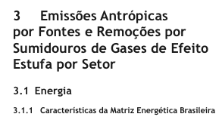
Segunda Comunicação Nacional do Brasil à CQNUMC

Slide 52
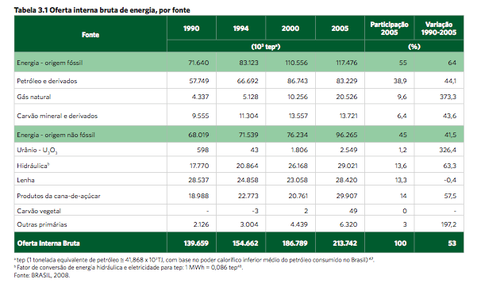


Slide 53
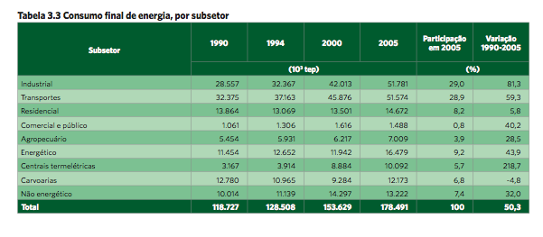

Slide 54
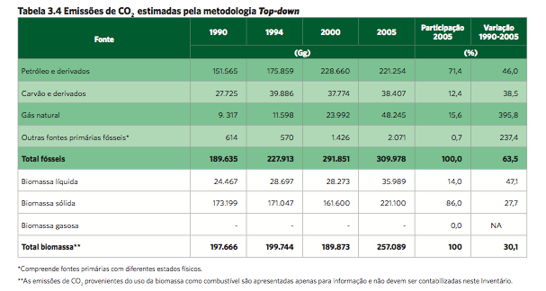
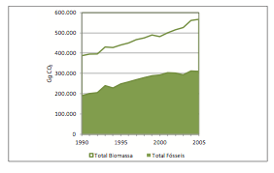


Slide 55
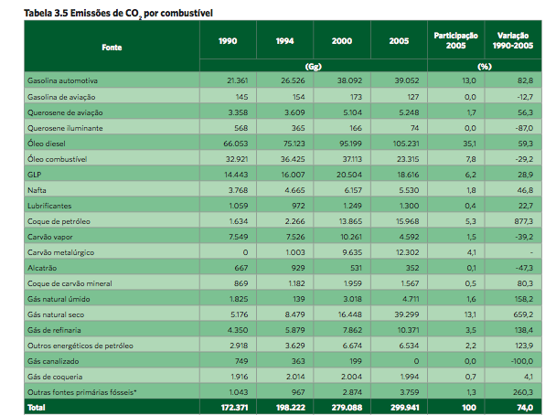

Slide 56
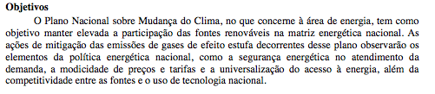

ATUALIZAÇÃO DO PLANO NACIONAL
SOBRE MUDANÇA DO CLIMA
Subsidiado pela 2ª. Comunicação

Slide 57

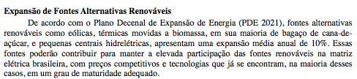

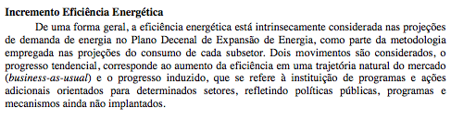

Slide 58
Terceira Comunicação Nacional do Brasil à CQNUMC (em elaboração)
Descreve programas e iniciativas governamentais que contribuem para a redução da emissão de gases de efeito estufa de forma consistente.
Estruturada em cinco partes:
I - Circunstâncias nacionais;
II - Inventário Brasileiro de Emissões Antrópicas por Fontes e Remoções por Sumidouros de Gases de Efeito Estufa não Controlados pelo Protocolo de Montreal;
III - Providências previstas ou já implementadas no país;
IV - Outras informações consideradas relevantes para o alcance do objetivo da Convenção, abrangendo transferência de tecnologia; pesquisa e observação sistemática; educação, treinamento e conscientização pública; formação de capacidade nacional e regional; e informação e formação de rede; e
V – Dificuldades para a execução.

Slide 59
Obrigado
osvaldo.moraes@mct.gov.br

